Slide 1
Black Holes and Fireballs at the LHC
ECT* Trento 21-6-2013
Anastasios Taliotis
Vrije Universiteit Brussel
arXiv:1212.0528; published in JHEP

Slide 2
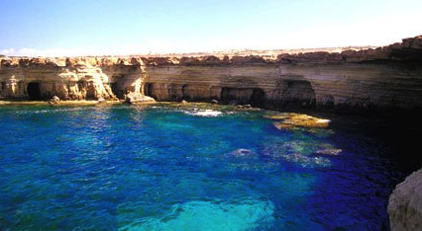

Before we start. Because of this
Must advertise this

Slide 3
Outline
Review Shockwave collisions in GR
Trapped surface analysis, an elementary introduction
Flat backgrounds, applications to BHs production at the LHC and extra dimensions
AdS backgrounds and applications to QGP production at the LHC
Summary/conclusions/take home message

Slide 4
Review Shockwave collisions
Studied by many authors in both backgrounds
[Ads:,Albacete,Kovcegov,Taliotis;Romatscke,Mateos-Solana et.al,Wu, Chesler,Yaffe,Heller,Janik,Peschanski…, Flat:’t Hooft,D’Eath, Payne,Giddings,Tomaras,Taliotis, Herdeiro et.al…]
Single shock wave geometry

Slide 5
Essential formulas
Restricted SO(3) invariant shocks:
z_{o} estimates the center of ρ in the 5th dimension.
Also the width of T_{μν} in gauge theory side. Although expected, NOT trivial to show this for any ρ.

Slide 6
What does this describe in gauge theory?
Can show g₊₊ |_{bdry} ~ T₊₊. Since g₊₊ |_{bdry} ~ f(x_perp)δ(x⁺)
It implies that this geometry describes a thin fast glueball along x- having a
having a transverse profile .
Figure taken from GYP
z=z₀
T₊₊

Slide 7
Superimpose two shocks: Add another one along the opposite direction
Shocks talk each other at x₋>0, x₊>0

Slide 8
Introduction to TS

Slide 9
Important Clarifications
What this method does not do: does NOT provide info for g_{μν} on future LC
What this method can do: provides a suggestion that a BH is formed by reducing to unusual BV problem. In what follows we will assume that a BH is always formed.
TS yields a lower bound on entropy production S_{trap}≤S_{prod}
[Giddings,Eardly,Nastase,Kung,Gubser,Yarom,Pufu,Kovchegov,Shuryak,Lin,kiritsis,Taliotis,Aref’eva,Bagrov,JoukovskayaVenezianoAlvarez-Gaume,Gomez,Vera,Tavanfar,Vazquez-Mozo,...]

Slide 10
Trapped surface analysis introduction (D=4, flat backgrounds)
If there is a function ψ and some curve C s.t.
then there exists a trapped surface and it is enclosed inside the curve C.
Example: Let the shock φ=EG₄Log(kx⊥) ala AS
Then ψ=EG₄Log(x⊥/EG₄ ) and C : x_{⊥;C}=EG₄
And S = A/4G₄ ~ ∫d²x⊥~E ²G₄
[Giddings & Eardley, 2002]

Slide 11
AdS Backgrounds and QGP

Slide 12
Trapped Surface Condition
Where k≡1/z_{o}. Note the dimensionless parameter controlling the TS!! E/k Vs E × k in flat backgrounds. Interesting!!
We will classify ρ’s under the assumptions
(i) ρ is positive definite
(ii) ρ is integrable. (i)+(ii)=> 3+1 cases
(iii) (qρ(q))’=0 has at most one root in (0, ∞)=> 3 cases
There are 3 cases (again) depending on how ρ behaves at small q’s!

Slide 13
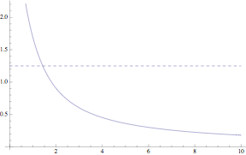
Case I. Always a single TS
Case I.: ρ ~ 1/q^{n} +sub-leading, q<<1, 3/2>n>1/2.
(always a single TS)

Slide 14
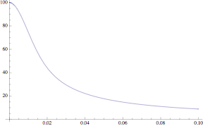
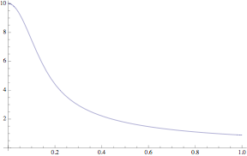
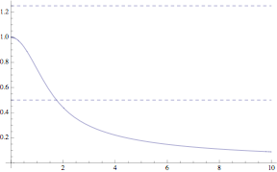
Case II. A marginal case: A single TS for sufficiently large E x k
ρ ~ 1/√q +sub-leading, q<<1.
(a single TS if E>>k)

Slide 15
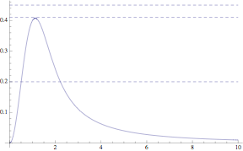
Case III. Two TS for sufficiently large
E x k
Case III. ρ ~ 1/q^{n} +sub-leading, q<<1, n<1/2.
(2 co-eccentric TSs if E>>k)
“RN-like” scenario in the absence of charge [Mureika,Nicoli,Spallucci;Taliotis]

Slide 16
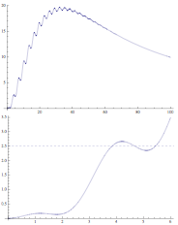
The 3rd+1 case
Remove the
(xρ(x))’=0 has
a single root

Slide 17
Universal Results
Can show that any ρ yields a φ s.t. at q>>1 decays as 1/q³ as dictated by holographic renormalization considerations [skenderis et. al.]
The TS, at the HE limit: k/E<<1, always grows as q_{c}³=E/k with k NOT dropping out.
Can also show S ~ q_{c}² and so S~ (E/k)^{2/3}

Slide 18
Application in heavy ions
RN-like scenario:
*As E grows, outer horizon grows but inside shrinks.
*Inside horizon is TD unstable; could mimic a hotter unstable core loosing heat to the outer shell and going through a phase transition (hadronization).

Slide 19
Desired feature captured
Seen that a BH, hence QGP, may exist if E>>k.
But k is the transverse scale of the SE tensor in QFT; that is scale of colliding glue-balls.
Tempted to identify k with Λ_{QCD}
This would imply forming QGP⬄E>>Λ_{QCD}
Although expected, it is first time in literature such feature is described theoretically; in present context holographically.

Slide 20
Incorporating strong-weak coupling physics and saturation scale: a phenomenological approach

Slide 21
Attempting to fit RHIC and LHC data
A phenomenological approach
Relate S with total multiplicities N
Use CGC model, in particular the saturation scale.
Incorporate weak-strong coupling physics.

Slide 22

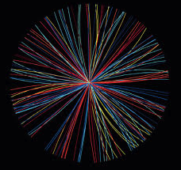
Multiplicities N_{ch}
QGP and
hydrodynamic expansion
hadronic phase
and freeze-out
initial state
SW’s
S_{prod}
ISENTROPIC
pre-equilibrium
hadronization

Slide 23
Relating S with N_{ch}
Since N_{CH} ~ S_{GT}=AdS/CFT=S_{ST}>S_{TS}. Numerical works
[Hogg,Romatschke,Wu] show S_{ST}=bS_{TS} where b is collision energy
independent
On the other hand, overall constants (gravity parameters s.t.
G5/L³) must be fitted with data. Hence schematically work as
    N_{ch} = (fit b)×S_{TS}

Slide 24
Connection with data
Seen that N_{CH}~S~(E/k)^{2/3}
k could generally be E dependent
Take k=Q_{s}(E) and use Q_{s} from pQCD results
This means that the transverse scale of colliding ultra-fast pancakes is set by Q_{s} rather than Λ_{QCD}.

Slide 25
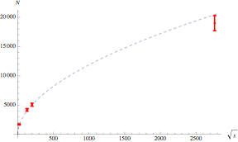
Then N ~ (E/Q_{s}(E))^{2/3} ~ (s/Λ_{QCD})^{1/3(1-λ)}, λ=[0.1,0.2] where λ~0.2 for AA collisions
Hence N ~ (s/Λ_{QCD})^{0.26} and fit constant using the data. Choosing the (s independent) constant 300 yields

Slide 26
Summary
Gave an elementary intro to TS/review known results.
Classified transversally symmetric distributions according to the TSs that can create (for flat and AdS backgrounds).
Found universal results in both, the geometries at large arguments and at the S in the HE limit.

Slide 27
Take home messages
Applied to BHs at LHC: No ED=>No BHs but ED=>BHs open scenario (did not study this here).
QGP⬄ E>>Λ_{QCD}. First time to be described theoretically.

Slide 28
Thank you
28

