Slide 1
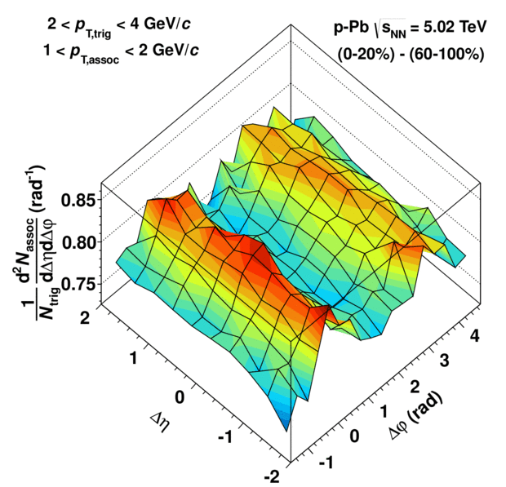
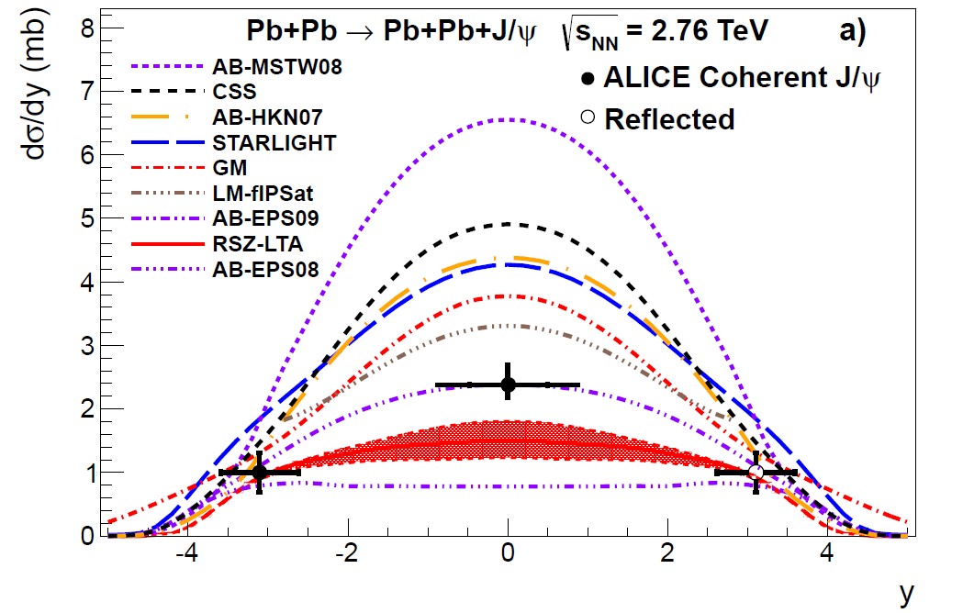
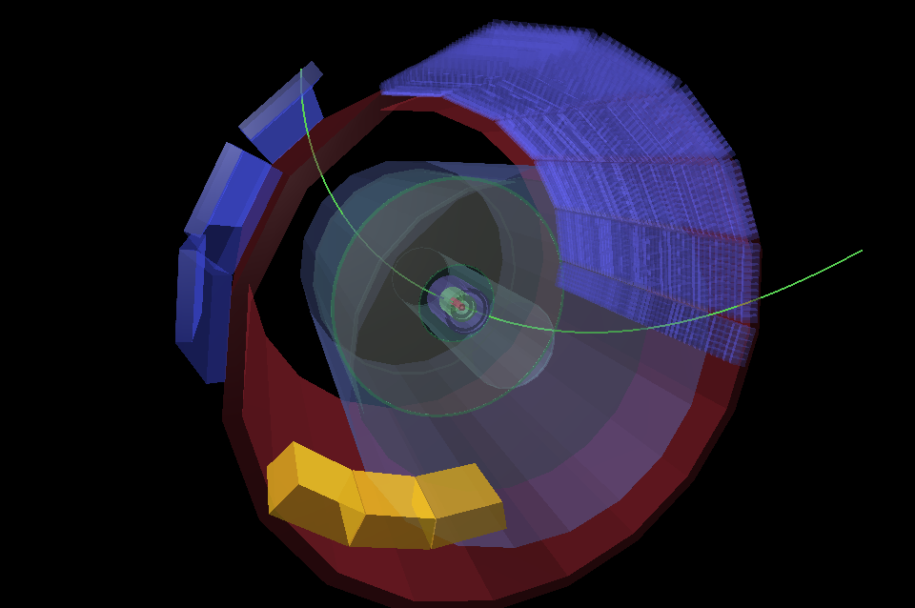
ALICE latest result on soft QCD and low x physics in pp, p-Pb and Pb-Pb collisions
E. Scapparone (INFN-Bologna)
on behalf of the ALICE Collaboration,
h3QCD, Jun 20, 2013

Slide 2
The gluon rise
R ~ 1/Q²
Gluon saturation expected at high energy and low x:
σ = α/Q² ; ρ= xG_{A}(x,q2)/πr² ρσ ~ 1
Saturation scale:
Q² < Q²_{s} ~ A^{1/3} / x^{l} , l~0.3 → saturation at low x: large
A (nuclei) amplification
At RHIC : → Q²_{s} ~ 1-2 GeV² (at the limit of the
perturbative approach)
At LHC : → Q²_{s} ~ 5 GeV² (perturbative probes)
The growth of the parton densities with decreasing x must be limited to satisfy unitarity bounds. → gluon saturation
Q²s,LHC ~ 3 Q²s,RHIC Q²s,Pb ~ 6 Q²s,p Q²s (y=3) ~ 2.5 Q²s (y=0). Saturation should start at larger Q² in Pb-Pb collisions wrt p-p collisions and at forward wrt central rapidity.

Slide 3
CGC ?
A possible description:
CGC
Colour → gluon charge
Glass → borrowed from the term for silica: disordered and acts like solids
on short time scales but liquids on long time scales. In the “gluon walls,”
the gluons themselves are disordered and do not change their
positions rapidly because of time dilation.
Condensate → gluons have high density
Large x partons → colour source, static during the lifetime of the short lived small x partons
Sheets charge up with colour electric and
colour magnetic charge (GLASMA)
CGC
CGC requires saturation

Slide 4
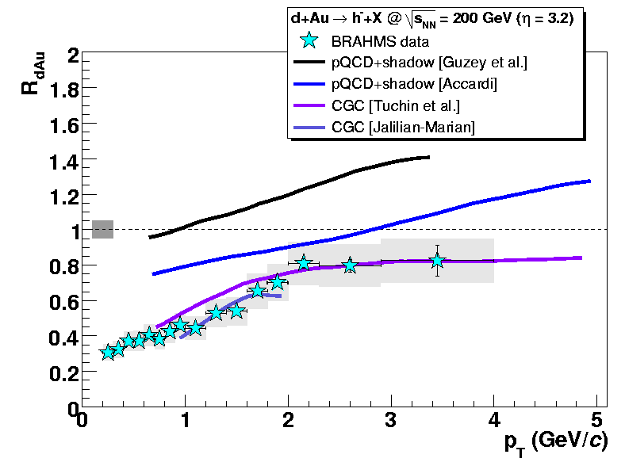
Hints of saturation from RHIC
IS the CGC there ?
PRL 93, 242303 (2004)
p_{T} e^{−η}
√s
x ~
At forward rapidity and low p_{T} (small-x partons probed in the nucleus), R_{d+Au} decreases
→ not explained by pQCD NLO calculations and shadowing
→ signature for a possible onset of gluon saturation at RHIC energies
.. instead of the deuteron colliding and interacting
with individual nucleons in the gold nucleus,
it was hitting a bunch of protons simultaneously—
or a dense field of gluons that acts like sticky molasses,
making it harder for particles with a given
momentum to be produced.

Slide 5
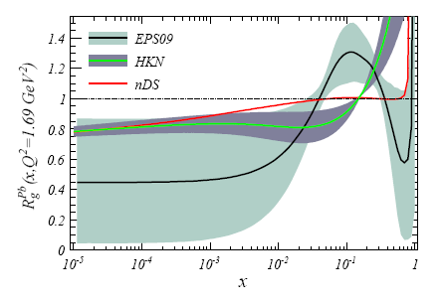
The colour field in the nucleus: Nuclear Gluon shadowing
Nuclear gluon shadowing factor vs x
G_{Pb}(x,Q²)
R_{g}^{Pb}(x,Q²) =
A G_{p} (x,Q²)
Soft QCD
The bulk of particle production at LHC is dominated by soft hadrons → small x (x ~ p_{T}/√s).
The dependence of the charged-particle multiplicity density on energy and system size reflects the interplay between hard parton-parton scattering processes and soft processes.
Nevertheless: keep in mind saturation-based models make predictions for initial-state gluons, while the measured multiplicity is that of hadrons in the final state

Slide 6

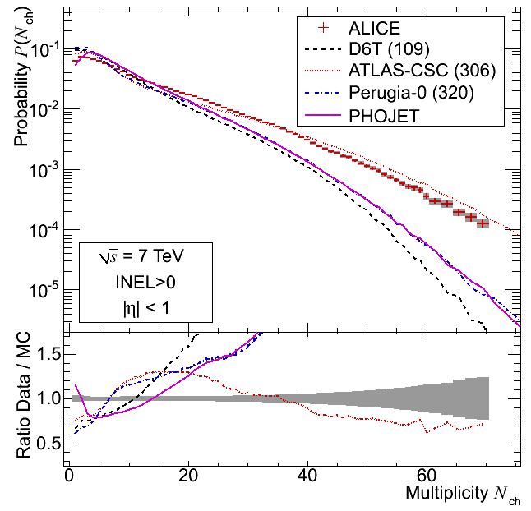
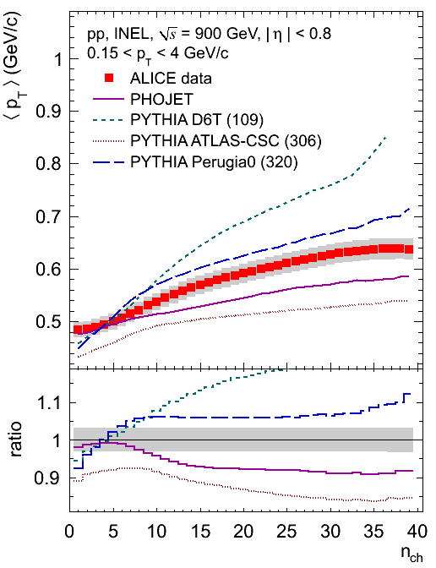

Modeling soft QCD at LHC is not trivial…
Relative increase in dN_{ch}/dη
EPJ C68 (2010), 89
EPJ C68 (2010), 345
but..

Slide 7
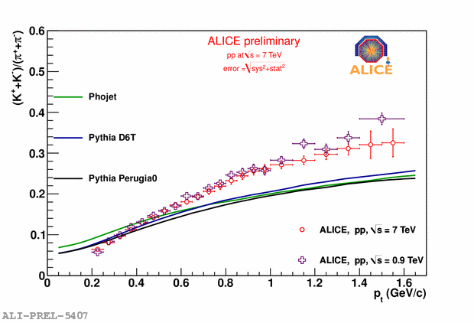
s-quark: soft events, but their modeling is a hard job…..
K/π
Ω
Ξ
Several tunes were tested, among them PYTHIA Z2, Perugia 2011 and Perugia 0 tunes. These tunes were several times to an order of magnitude below the measured multi-strange spectra and yields (up to a factor 4 for Ξ±, 15 for Ω±).
Phys. Lett. B 712(2012) 309
Phys. Lett. B710 (2012) 557

Slide 8
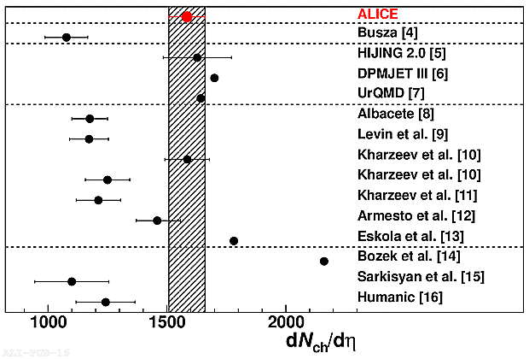
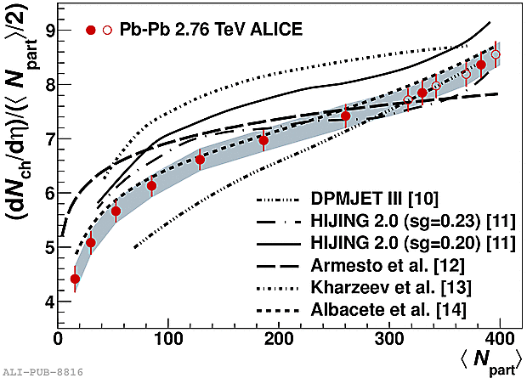
Pb-Pb: dN/dη
The dN/dη distribution is closely connected with the number of partons released in initial state: dN/dη ∝ xG(x,Q²) ⋅ A^{1/3}
Models based on initial-state
gluon density saturation have
a range of predictions
depending on the specific
implementation [8–12] and
exhibit a varying level of
agreement with the
measurement.
Lower en. data extrapolation
Dual parton model, pQCD
Saturation
Sat. + hydro
Hydro, p-p multiplicity scaling
Hydro
Pythia + hadron rescattering
several saturation models
predict a lower multiplicity
Too strong rise
<dN/dη> = 1584 ±4(stat) ±76(sys)
Saturation models: few of them saturate too much

Slide 9
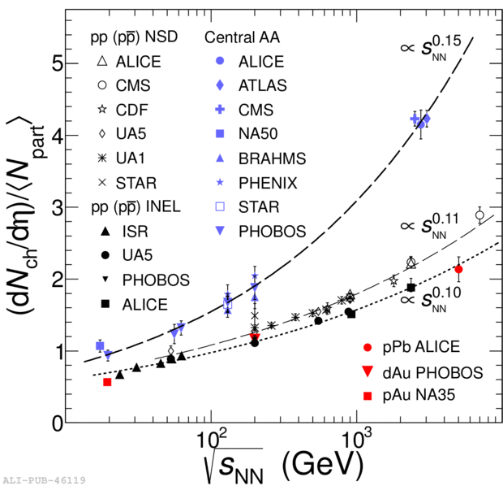
Pb-Pb
PRL 110, 032301 (2013)
The power-law behaviour in AA is different from pp. The energy dependence is steeper for heavy-ion collisions than for pp and pA collisions.
Q²_{s} ~ A^{1/3} / x^{λ} fit to Hera data gives λ ∼ 0.3
dN/dη ~ (√s) ^{λ} ◊ λ ∼ 0.15∗2 ∼ 0.3

Slide 10
p-Pb
● LHC operated with 4 TeV proton beam and 1.57 TeV/nucleon Pb beam
● Center of mass energy √s = 5.02 TeV per nucleon pair
● Center of mass rapidity shift Δy = -0.465 in the proton direction
● 2012 pilot run (4 hours of data taking)
● About 1/μb per experiment with very low pileup
● 2013 long run (3 weeks of data taking)
● Delivered about 30/nb to ATLAS, CMS and ALICE
● Beam reversal (relevant for ALICE and LHCb) for about half of statistics
● Van der Meer scans in both beam configurations

Slide 11
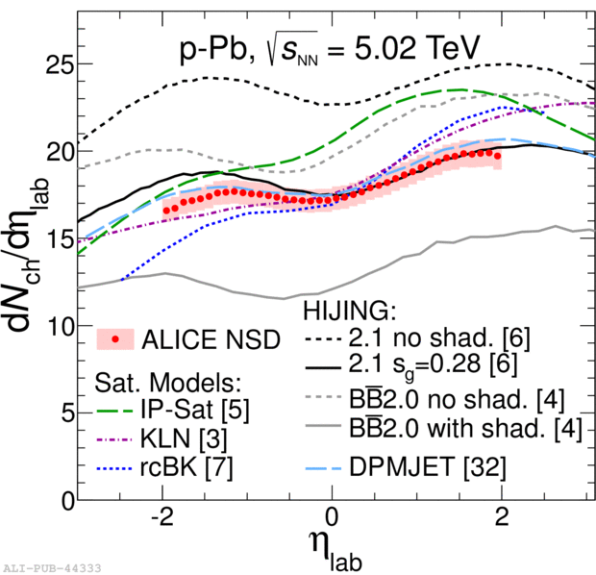
p-Pb
Particle production in proton-lead collisions, in contrast to pp, is expected to be sensitive to nuclear effects in the initial state.
At LHC energies, the nuclear wave function is probed at the small parton fractional momentum x. Gluon saturation theoretical description varies between models of particle production, resulting in significant differences in the predictions of the charged-particle pseudorapidity density.
→ Good tool to constrain and potentially exclude certain models and enhance the understanding of QCD at small x and the initial state.
- Data favour models including shadowing
- Saturation models predict too steep η
dependence
PRL 110, 032301 (2013)

Slide 12
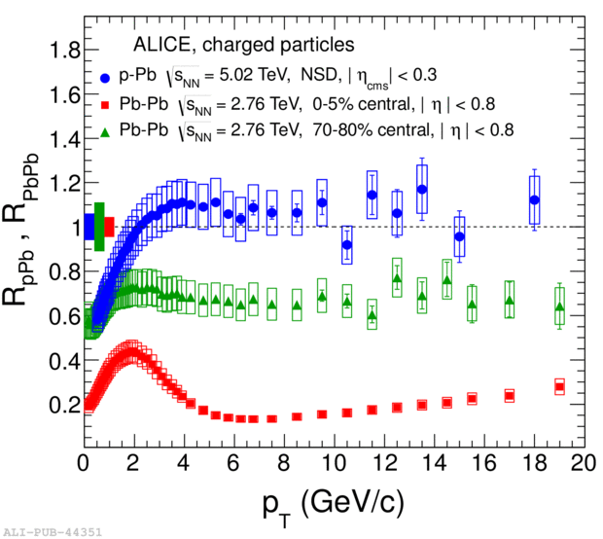
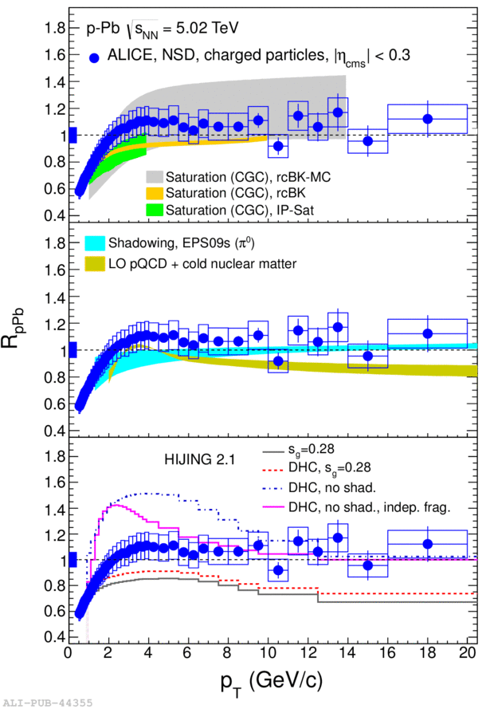
p-Pb
No suppression
At high p_{T}
Suppression at high p_{T}
is not an initial state
effect
PRL 100, 082302 (2013)
Compatible with 1 above 2-3 GeV/c
→ binary scaling is preserved, no (or small) initial state effects
No sign ( or weak) Cronin effect
p_{T} spectrum not reproduced by HIJING or DPMJET.
Both saturation models and models with shadowing can reproduce data

Slide 13
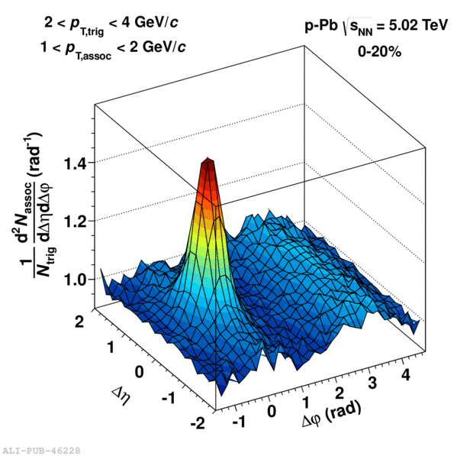
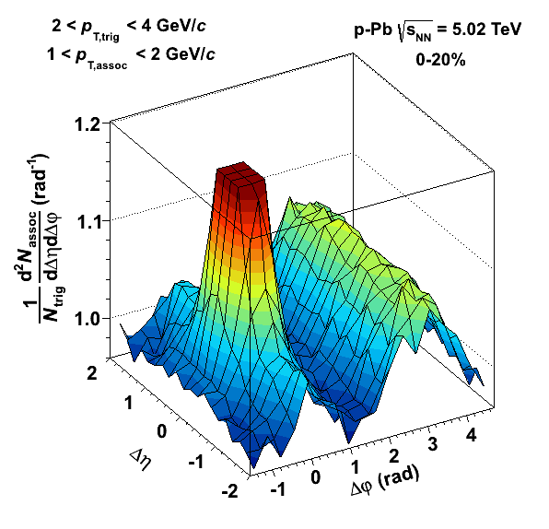
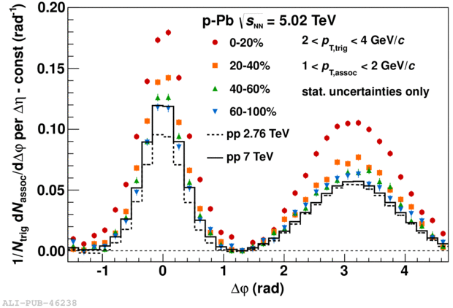
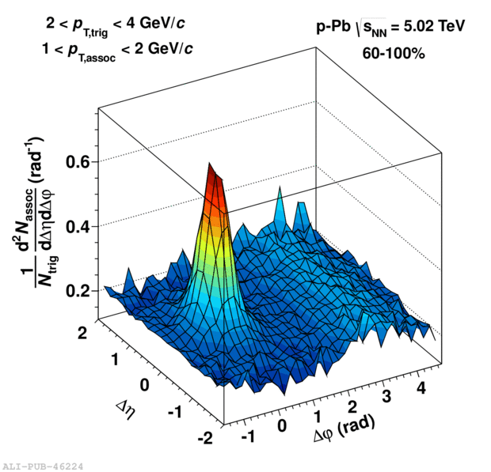
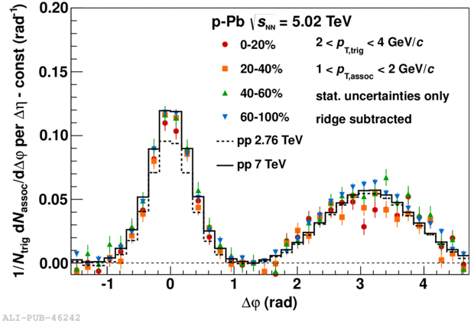
p-Pb: the ridge
Correlation between a trigger and an associated particle in a given p_{T} interval.
Excess on both near-side (NS) and away-side (AS) going from low multiplicity ->
high multiplicity events
S →correlation within the same event
B → correlaltion between different events
PLB 719 (2013) 29
No further significant
modification of the jet structure at midrapidity in high-multiplicity p–Pb collisions at the LHC

Slide 14
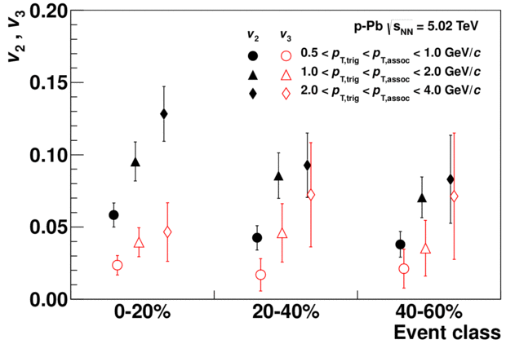
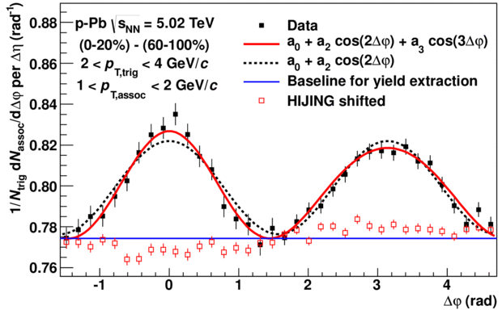
p-Pb: the ridge
Can we separate the jet and the ridge components?
  No ridge seen in 60-100% and similar to pp
  → what remains if we subtract 60-100%?
A double ridge structure !
0-20%
60-100%
-
=
Mostly cos(2Δφ),
but cos(3Δφ) is also there
extracted from the data
1 dN_{assoc}
N_{trig} dΔφ
=a₀+2a₂cos(2Δφ)+2a₃cos(3Δφ)

Slide 15
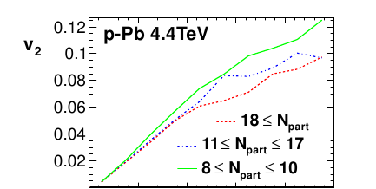
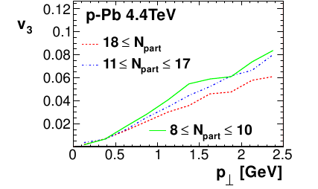
p-Pb: the ridge, possible interpretations:
Flow: 3+1 viscous hydro
P. Bozek, (arXiv:1112.0915)
N_{part} ≥ 18 0−4%,
11 ≤ N_{part} ≤ 17 4-32%
8 ≤ N_{part} ≤ 10 32-49%
CGC
CGC
K. Dusling, R. Venugopalan
arXiv:1302.7018
AALICE 0-20 % centrality

Slide 16
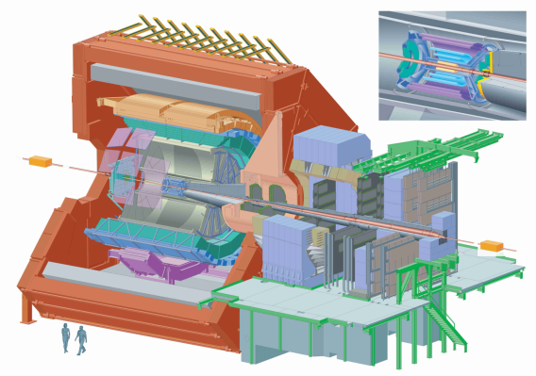
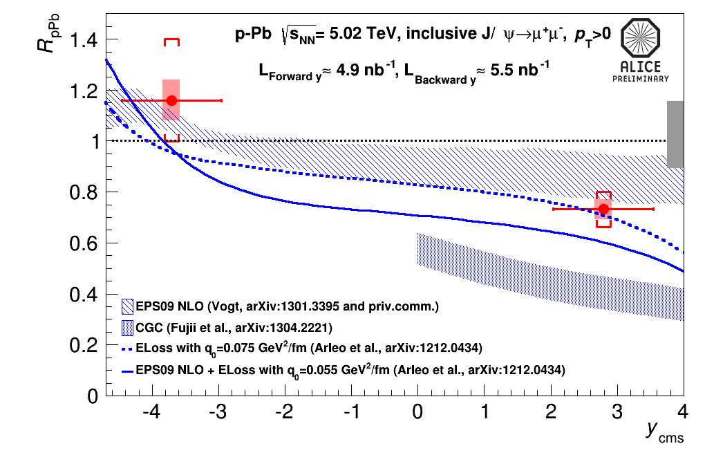
J/Ψ in p-Pb
p
Pb
Pb
p
2.03<y_{CMS}<3.53
-4.46<y_{CMS}<-2.96
dominant error source is due to
the normalization to pp collisions
Shadowing EPS09 NLO calculations (R. Vogt) and models including coherent parton energy loss contribution (F. Arleo et al) reproduce the data.
CGC description (Q²_{S0,A} = 0.7-1.2 GeV/c², H. Fujii et al) seems not to be favored

Slide 17
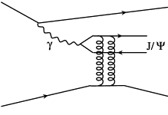
Ultra Peripheral Collisions at LHC
b
EM field → photon flux
When hadronic cross section becomes negligible
(b>2R) photons can give:
R
Pb
Pb
Pb
Coherent vector meson production:
photon couples coherently to all nucleons
⟨ p_{T}⟩ ~ 1/R_{Pb} ~ 60 MeV/c
no neutron emission in ~80% of cases
Incoherent vector meson production:
photon couples to a single nucleon
⟨ p_{T}⟩ ~ 1/R_{p} ~ 500 MeV/c
target nucleus normally breaks up
Pb
Pb
Pb
Pb
Pb
Pb

Slide 18
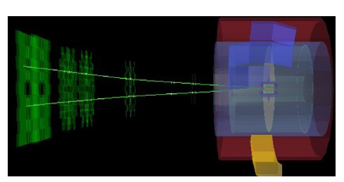
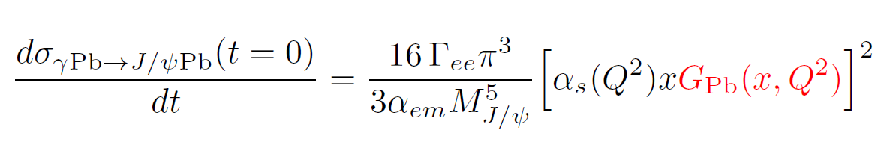
UPC as a probe to study gluon shadowing
Forward rapidity
Mid-rapidity
3.6 < y < 2.6
|y| < 0.9
Nuclear gluon shadowing factor vs x
G_{Pb}(x,Q²)
R_{g}^{Pb}(x,Q²) =
A G_{p} (x,Q²)
J/Ψ in Pb-Pb UPC is
a direct tool to measure
nuclear gluon shadowing
Bjorken x ~ 10⁻² – 10⁻⁵
accessible at LHC
Large uncertainties at small x

Slide 19
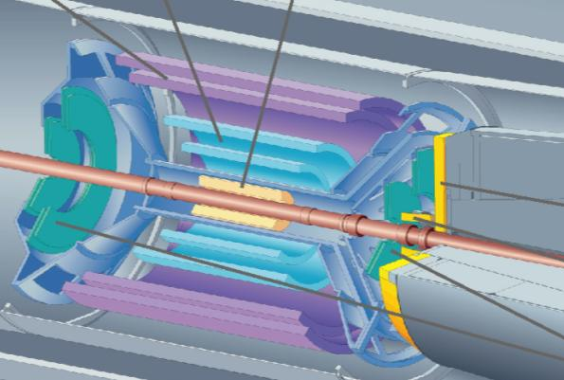
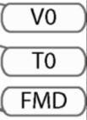
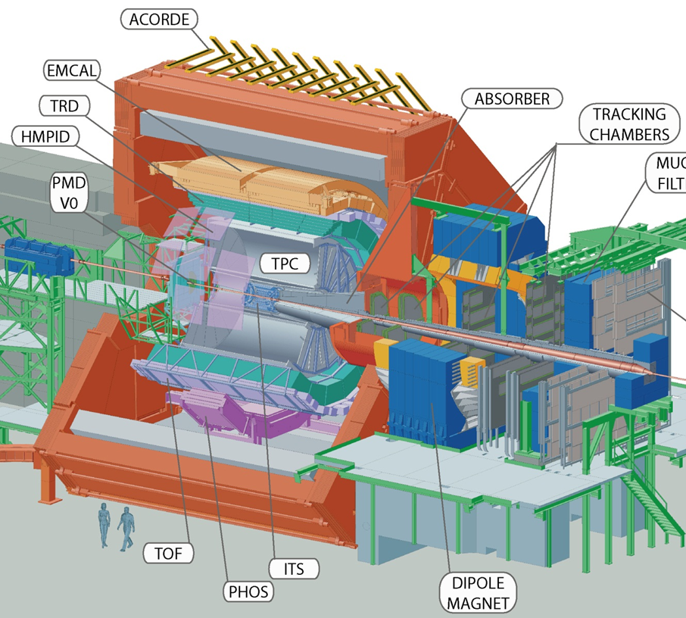
UPC J/ψ at central rapidity
UPC central barrel trigger:
2 ≤ TOF hits ≤ 6 (|η| < 0.9)
+ back-to-back topology (150° ≤ ϕ ≤ 180°)
≥2 hits in SPD (|η| < 1.5)
no hits in VZERO (C: -3.7 < η < -1.7, A: 2.8 < η < 5.1)
Offline event selection:
Offline check on VZERO hits
Hadronic rejection with ZDC
Track selection:
< 10 tracks with loose requirements
(|η| < 0.9 , > 50% findable TPC
clusters and > 20 TPC clusters)
Only two tracks: |η| < 0.9 , with ≥ 70 TPC clusters, ≥ 1 SPD clusters
p_{T} dependent DCA cut
opposite sign dilepton
|y| < 0.9, 2.2 < M_{inv} < 6 GeV/c²
dE/dx in TPC compatible with e/μ
ZDC
Integrated luminosity ~ 23 μb⁻¹

Slide 20
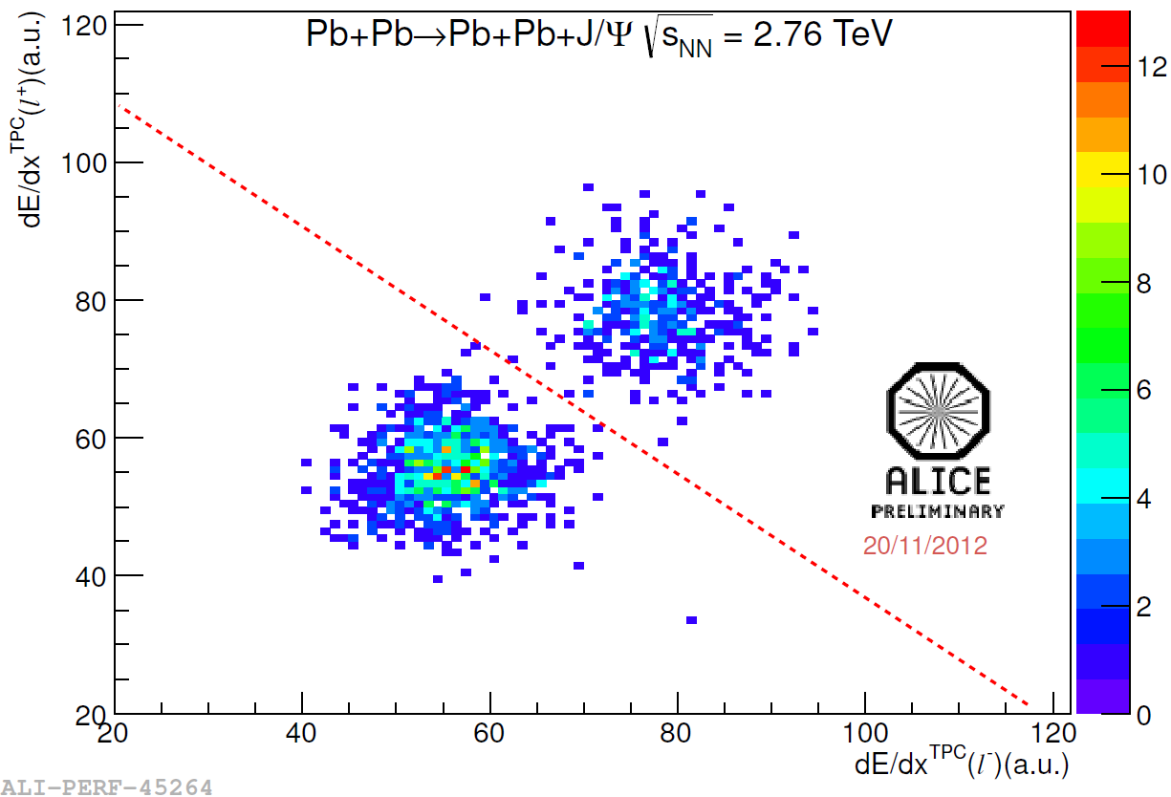
dE/dX selection in TPC
electrons
EMCAL
muons
dE/dx in TPC compatible with e/μ energy loss
Cross-checked with E/p in EMCAL
±2% systematics due to e/μ separation
P.S. we cannot distinguish μ from π

Slide 21
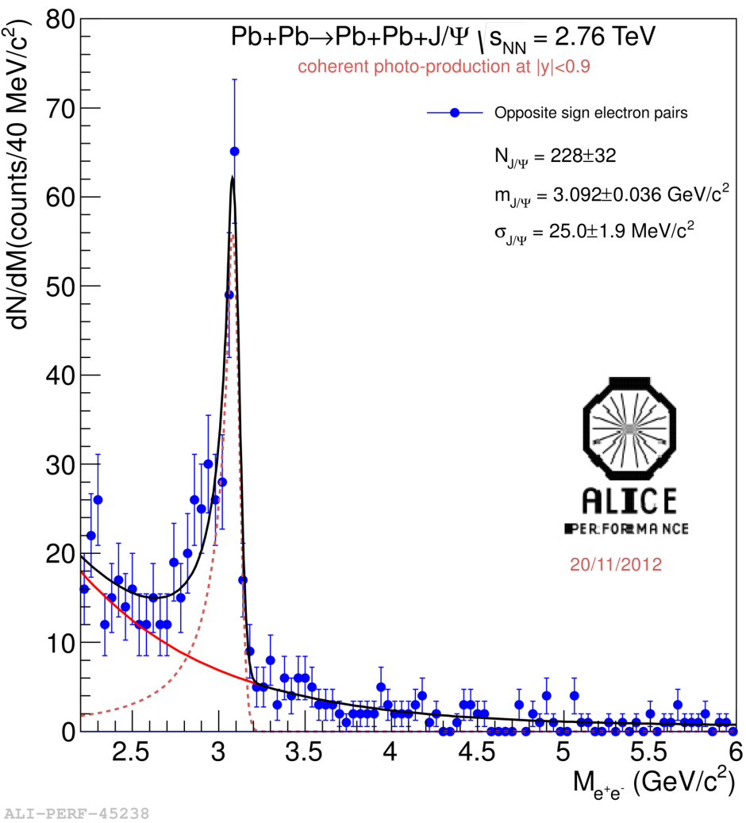
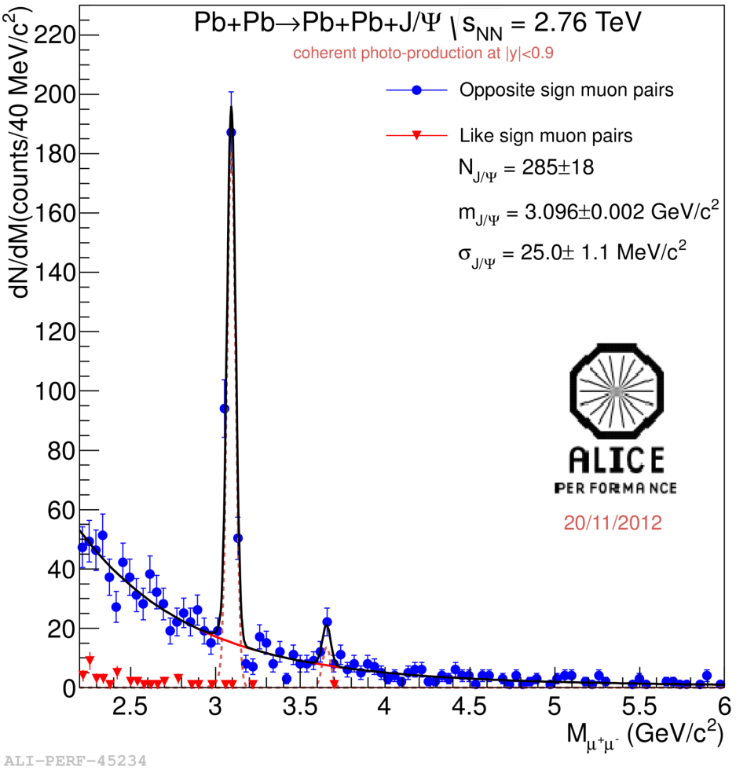
p_{T} < 200 MeV/c for di-muons (300 MeV/c for di-electrons) .and. < 6 neutrons in ZDC
→ Coherent enriched sample
ee
μμ

Slide 22
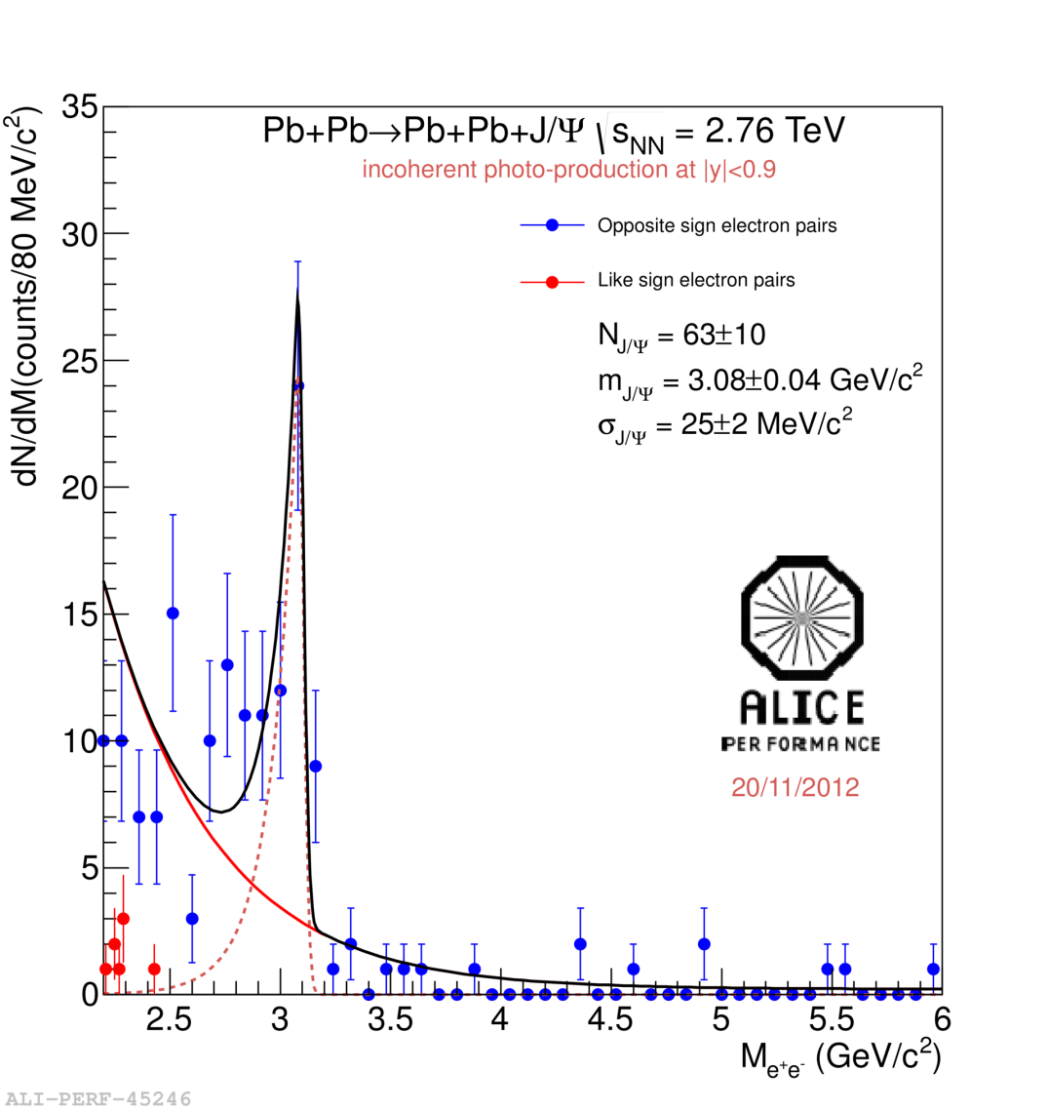
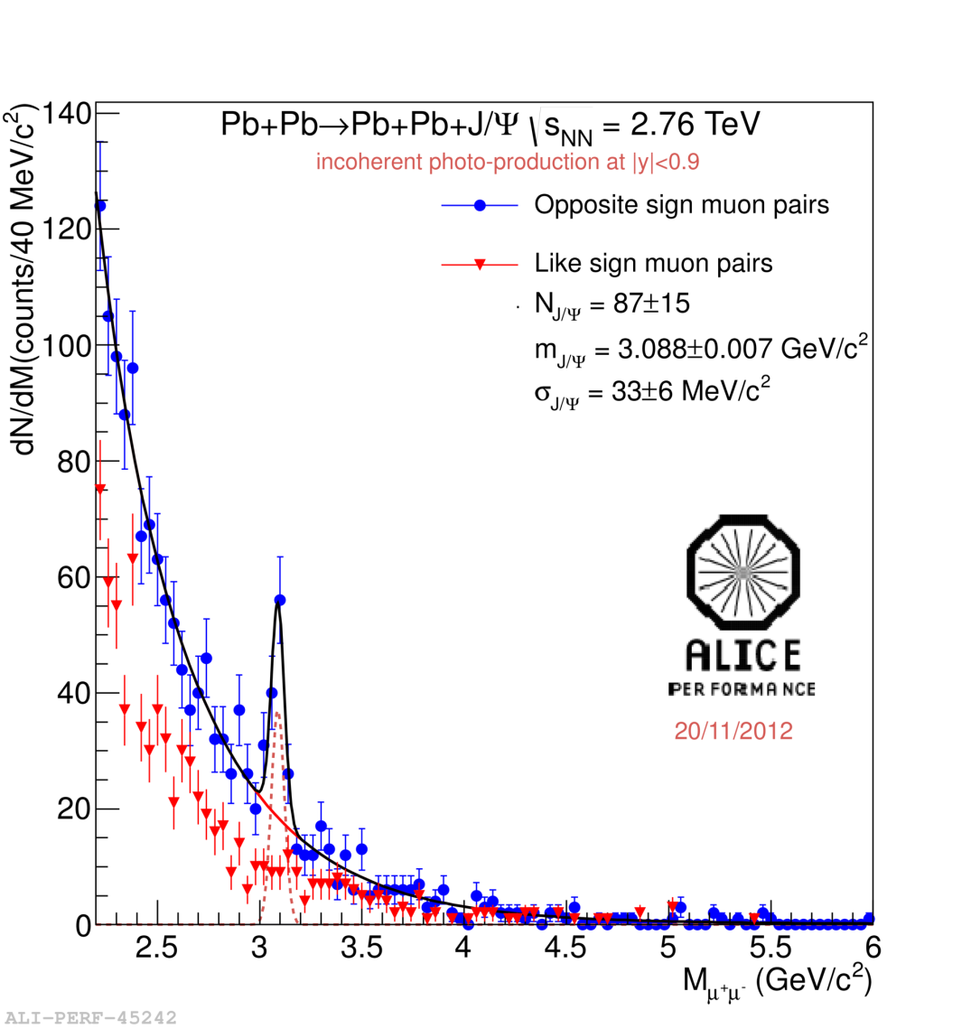
p_{T} > 200 MeV/c for di-muons (300 MeV/c for di-electrons)
→ Incoherent enriched sample
ee
μμ

Slide 23
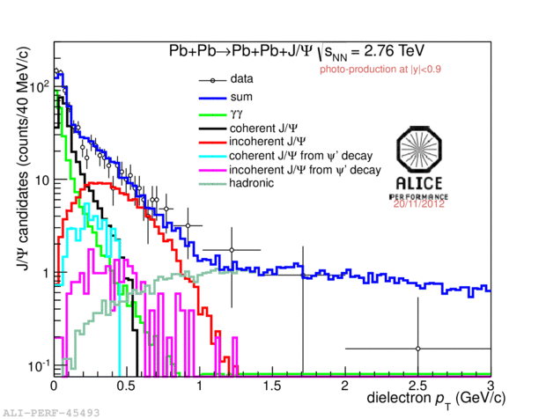
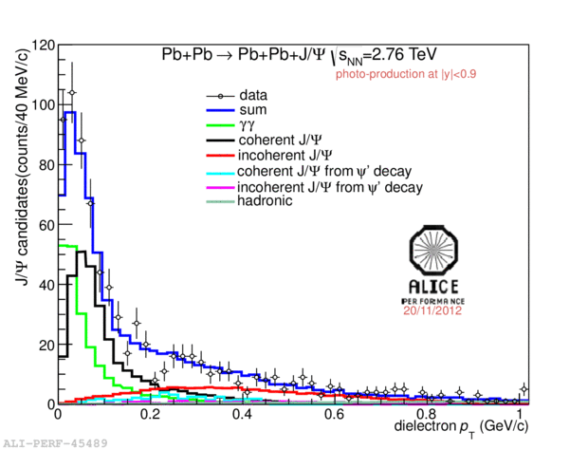
The J/Ψ peak region: 2.2 GeV/c² < M_{inv} < 3.2 GeV/c² for electron and
3.0 GeV/c² < M_{inv} < 3.2 GeV/c² for muons
Used templates:
- Ψ’ contribution to (in)coherent J/Ψ◊ f_{D};
Incoherent J/Ψ contribution to coherent J/Ψ (and vice-versa) → f_{I}
- γγ → l⁺l⁻ contribution to coherent J/Ψ
Hadronic J/Ψ;
Example: p_{T} spectrum for J/Ψ → e⁺e⁻ (similar plot for J/Ψ → μ⁺μ⁻ )
ee
ee

Slide 24
Detailed study of the systematics:

Slide 25
UPC J/ψ at forward rapidity
UPC forward trigger:
single muon trigger with p_{T} > 1 GeV/c (-4 < η < -2.5)
hit in VZERO-C (-3.7 < η < -1.7)
no hits in VZERO-A (2.8 < η < 5.1)
Integrated luminosity ~ 55 μb⁻¹
Offline event selection:
Beam gas rejection with VZERO
Hadronic rejection with ZDC and SPD
Track selection:
muon tracks: -3.7 < η < -2.5
matching with tracks in the muon trigger
radial position for muons at the end of absorber: 17.5 < R_{abs}< 89.5 cm
p_{T} dependent DCA cut
opposite sign dimuon: -3.6 < y < -2.6

Slide 26
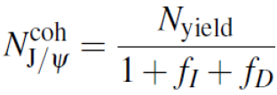

Four contributions in the p_{T} spectrum:
Coherent J/ψ
Incoherent J/ψ
J/ψ from ψ' decays
γγ →μμ
Invariant mass distribution:
Dimuon p_{T}< 0.3 GeV/c
Clean spectrum: only 2 like-sign events
Signal shape fitted to a Crystal Ball shape
Background fitted to an exponential
Exponential shape compatible with expectations from γγ →μμ process
ALICE: Phys. Lett. B718 (2013) 1273

Slide 27

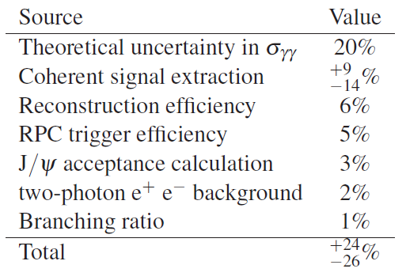
Phys. Lett. B718 (2013) 1273

Slide 28
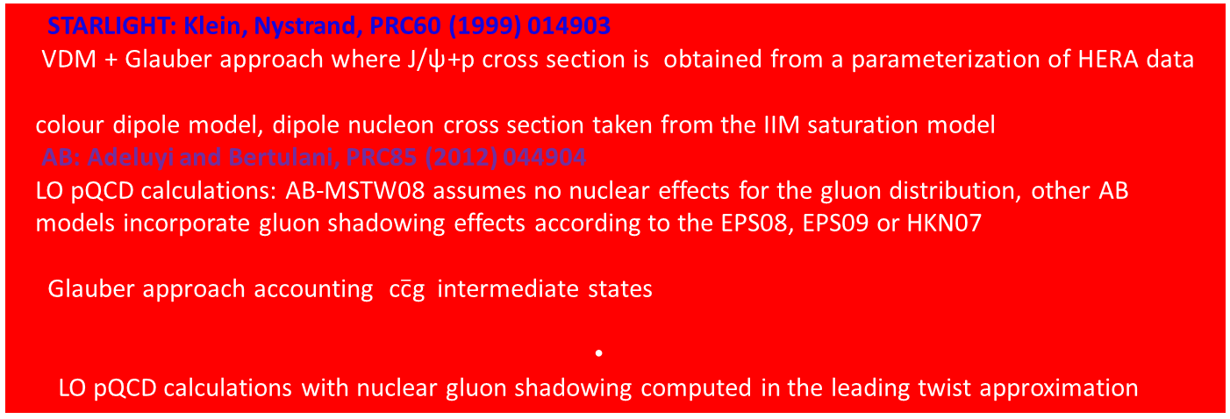
Coherent J/ψ: comparison to models
STARLIGHT: Klein, Nystrand, PRC60 (1999) 014903
VDM + Glauber approach where J/ψ+p cross section is obtained from a parameterization of HERA datas, Machado, PRC84 (2011) 011902
colour dipole model, dipole nucleon cross section taken from the IIM saturation model
AB: Adeluyi and Bertulani, PRC85 (2012) 044904
LO pQCD calculations: AB-MSTW08 assumes no nuclear effects for the gluon distribution, other AB
models incorporate gluon shadowing effects according to the EPS08, EPS09 or HKN07
Glauber approach accounting $\text{c}\overline{\text{c}}\text{g}$ intermediate states
LO pQCD calculations with nuclear gluon shadowing computed in the leading twist approximation
CSS:Cisek,Szczurek,Schäfer,PRC86(2012)014905
RSZ (Rebyakova, Strikman, Zhalov), PLB 710 (2012) 252
Good agreement with models which include nuclear gluon shadowing.
Best agreement with EPS09 shadowing
arXiv:1305.1467,
sent to EPJ-C
x ~ 10⁻²
x ~ 10⁻³

Slide 29
Conclusions
Fine tuning of the soft QCD event generator (PHOJET, Pythia) not trivial. Production of
hadrons with s-quark to be improved.
- Models including nuclear gluon shadowing reproduce UPC J/Ψ cross section, R_{p-Pb} for
inclusive yield and J/Ψ in p-Pb . Good agreement with dN/dη predictions
Models based on CGC reproduce properly the ridge, R_{p-Pb} for J/Ψ requires further tuning
Saturation model slightly too steep in dN/dη in p-Pb and 20-30% too low in
Pb-Pb <dN/dη> ;
A wealth of new data just published and many others on the way: soft QCD and low-x
models can profit of a large variety of results for their fine tuning.

