Slide 1
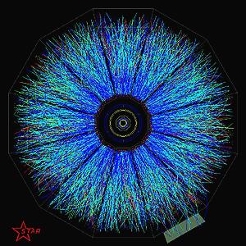
Latest results on triangular flow, correlations and jets from STAR
Jana Bielcikova
(for the STAR Collaboration)
Nuclear Physics Institute ASCR
Czech Republic
h3QCD workshop, ECT*, Trento, Italy, June 17-21, 2013

Slide 2
Outline
STAR experiment at RHIC
Measurements of triangular flow
Ridge studies in d+Au collisions
Forward di-hadron correlations
Ongoing jet studies in Au+Au collisions
Summary and outlook

Slide 3
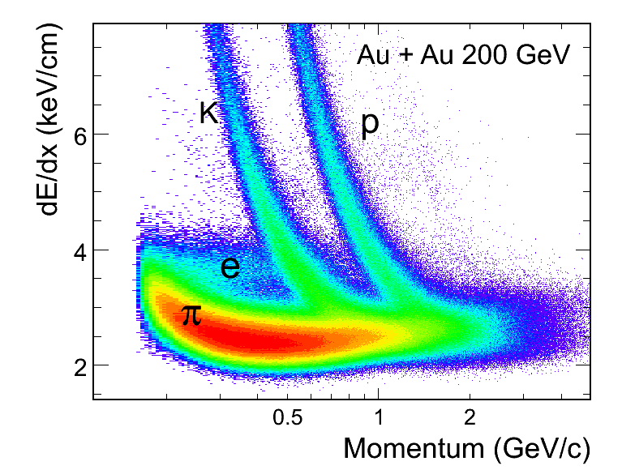
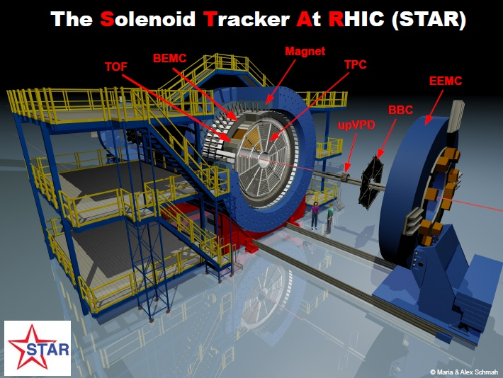
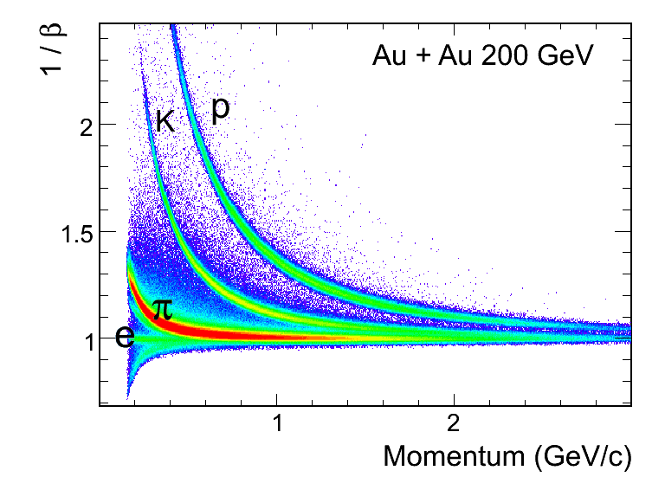
STAR experiment
Time Projection Chamber: dE/dx, PID, momentum
Time Of Flight detector: PID, 1/β
Barrel ElectroMagnetic Calorimeter: E/p, trigger
Endcap ElectroMagnetic Calorimeter (1.0 ≤ |η| < 2.0)
Forward Meson Spectrometer (2.5 < |η| < 4.0)
Forward Time Projection Chambers (2.8 < |η| < 3.8)
Full azimuthal acceptance:
0<φ<2π

Slide 4
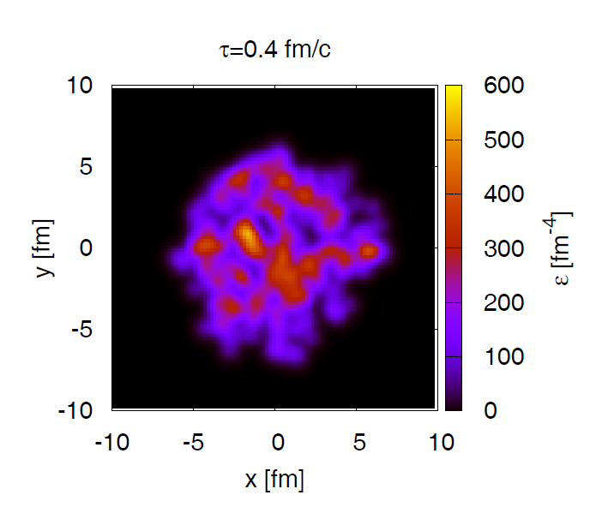
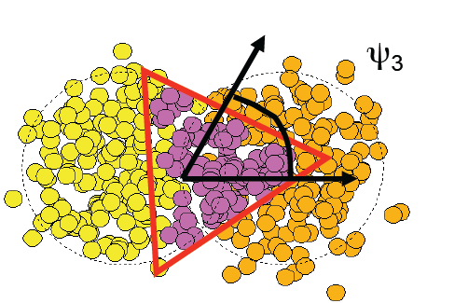
Triangular flow (v₃) …
participant
spectator
A
A
B. Alver, G. Roland, PRC81 (2010) 054905
B. Schenke, S. Jeon, C. Gale
PRL 106, 042301

Slide 5
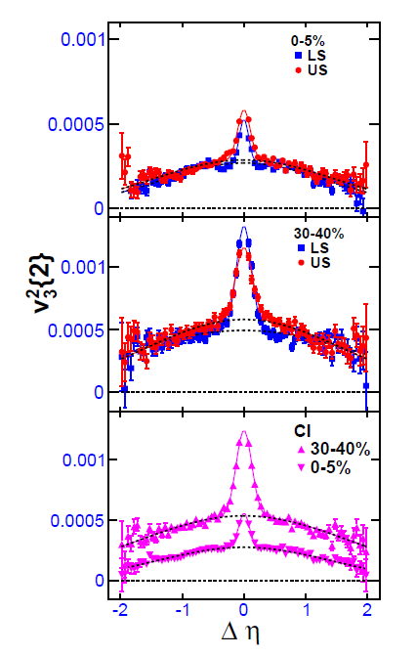
Methods to determine v₃
determination of v₃ from event plane method:
TPC event plane: determined at mid-rapidity from TPC tracks
using sub-events with a small Δη gap of 0.05
reduces self-correlation
FTPC event plane: a large Δη gap between EP and
TPC particles used for v₃
no self-correlation
wide Gaussian method: v₃²{2} = <cos[3(φ_{i}-φ_{j}]>_{i≠j}
data are fit with a wide
+ narrow Gaussians
(narrow Gaussian:
short-range correlations: BE,
resonances, Coulomb)
v₃{2} with |Δη|>1.0 gap
STAR, arXiv:1301.2187

Slide 6
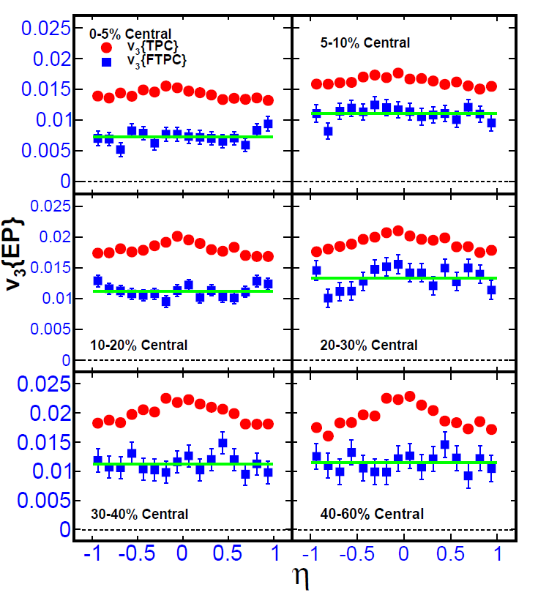
η dependence of v₃ in Au+Au collisions
STAR, arXiv:1301.2187
Data: Run 4 Au+Au @ 200 GeV
Two different event plane methods used:
TPC: sub-events with a small
Δη gap of 0.05
reduces self-correlation
FTPC: a large Δη gap between EP
and TPC particles used for v₃
no self-correlation
v₃{TPC} shows a small peak
around midrapidity
v₃{FTPC} is flat with pseudorapidity

Slide 7
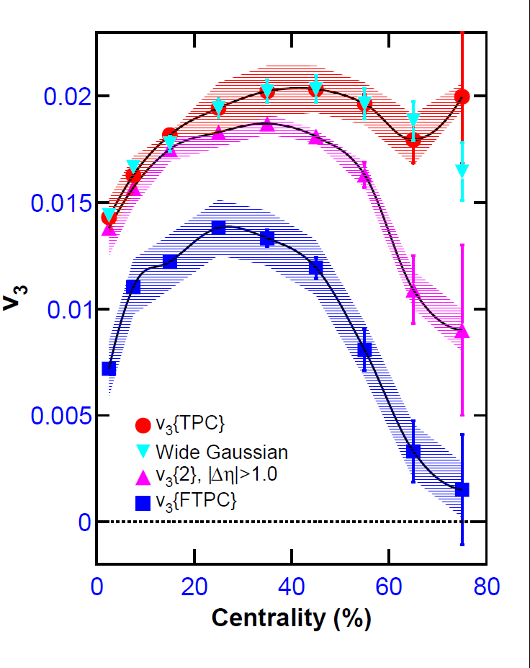
Centrality dependence of v₃ in Au+Au
collisions
STAR, arXiv:1301.2187
v₃ is integrated for:
0.15<p_{T}<2.0 GeV/c and -1<η<1
Large sensitivity of various v₃
analysis methods:
v₃{wide Gaussian} and v₃{TPC}
are similar: the narrow Gaussian
effect eliminated
Requiring a large Δη
→ v₃ values decrease
This decrease is more pronounced
in peripheral Au+Au collisions.
Let us have a closer look at the Δη dependence of v₃.

Slide 8
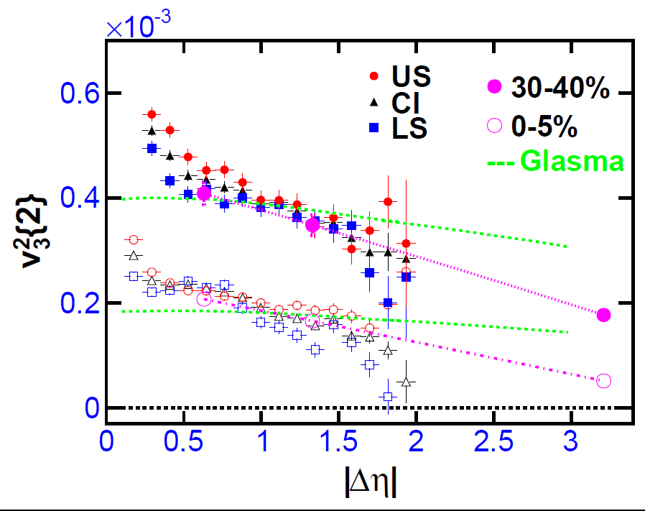
|Δη| dependence of v₃ in Au+Au collisions
STAR, arXiv:1301.2187
Glasma: Dusling et al. NPA 836, 159 (2010)
v₃²{2} gradually decreases
with |Δη|
within the STAR acceptance
v₃²{2} does not approach a
constant value
LS and US charge-sign
combinations show only little
difference despite different
contributions from resonances,
fluctuations and FS interactions
v₃²{TPC}
v₃²{2,|Δη|>1}
v₃²{FTPC}
similar decrease of v_{n}²{2}
observed also by ATLAS
PRC 86 014907 (2012)
Comparison with the Glasma model:
decreasing effect of fluctuations in the model?
For each v₃ value one must
always quote Δη range for which
it was calculated!
Glasma model is in a qualitative agreement with
the data, but the data show a steeper decrease.

Slide 9
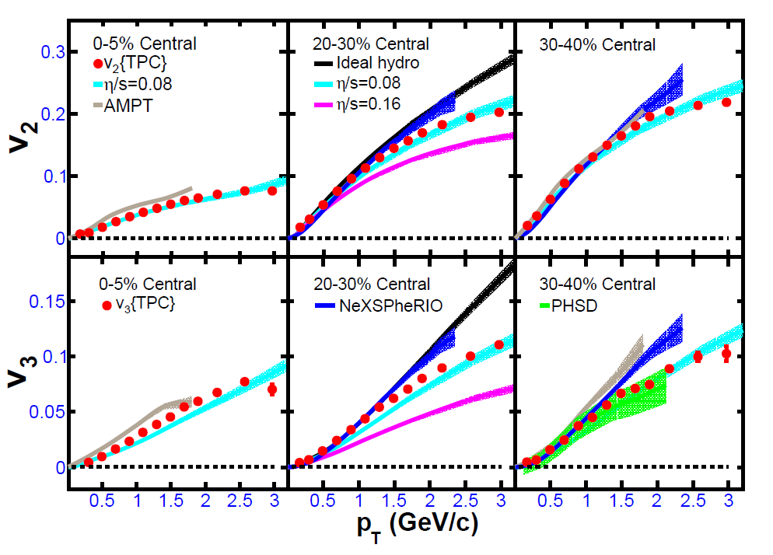
v₃(p_{T}) dependence and comparison with models
v₂: STAR, PRC 72, 014904 (2005); v₃: STAR, arXiv:1301.2187
Good agreement:
hydro with η/s=0.08
+Glauber initial conditions
NeXSPheRIO
for p_{T}<1 GeV/c
and 20-40% centrality
Parton-Hadron-
String-Dynamics model
semi-central collisions
- AMPT is a bit higher
- HIJING has negligible v₃
(not shown here)
Glasma model captures ≈ v₃(Δη) + models including fluctuations describe v₃(p_{T})
→ v₃ is likely mainly due to Δη dependent fluctuations
(+ possibly non-flow contributions).

Slide 10
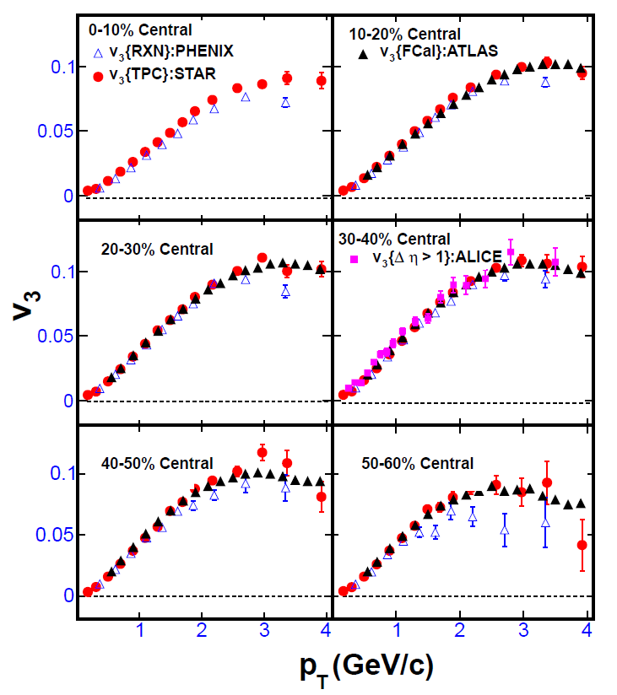
Comparison of v₃ to other experiments
STAR, arXiv:1301.2187
STAR data for v₃{TPC} agree well with
PHENIX v₃{RXN}
BUT: RXN acceptance: 1<η<2.8
i.e. <η> of RXN > TPC (?)
Surprisingly good agreement also
with the LHC experiments (?):
ALICE v₃ for |η| <0.8 and |Δη| >1
ATLAS v₃ for |η| <2.5 and |Δη| >2.5
BUT: fluctuations are expected to be
largely independent of collision
energy ☺

Slide 11
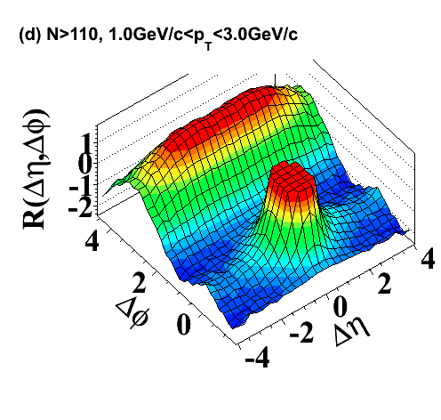
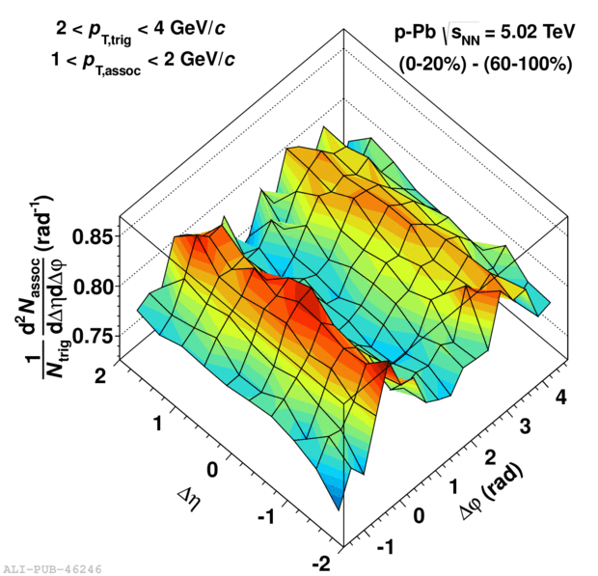
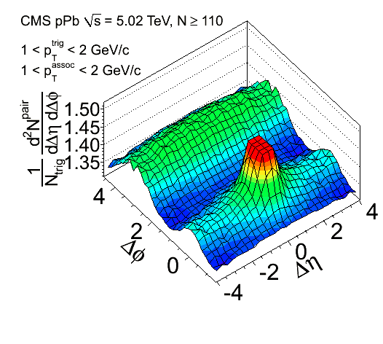
p+p, p+Pb, d+Au (?) ridge …
CMS, PLB 718 (2012) 795
ALICE, PLB 719 (2013) 29

Slide 12
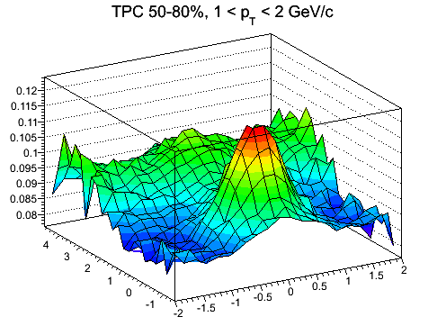
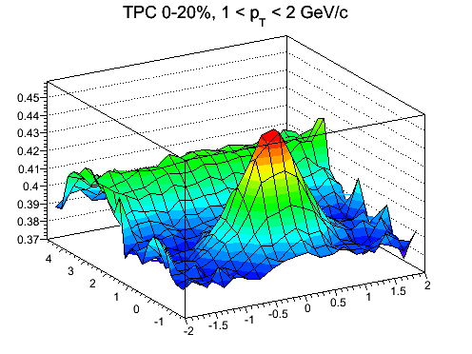
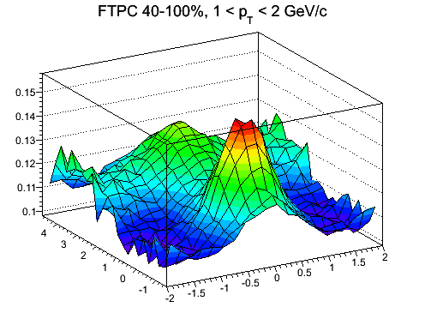
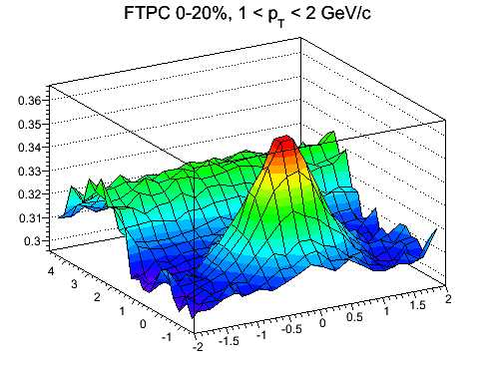
Di-hadron correlations in d+Au @ 200 GeV
Centrality determination:
STAR preliminary
STAR preliminary
TPC multiplicity
|η|<1.0
Δφ
Δφ
Δη
Δη
STAR preliminary
STAR preliminary
FTPC multiplicity
-3.8<η<-2.8
Δφ
Δη
Δφ
Δη
0.15 <p_{T}^{trig} < 3.0 GeV/c, 1<p_{T}^{assoc}< 2 GeV/c

Slide 13
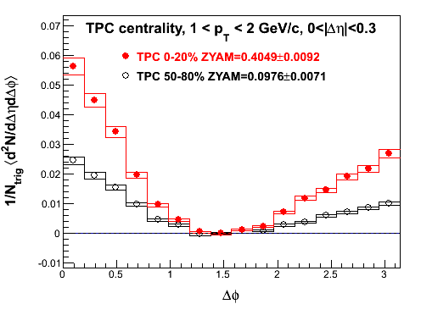
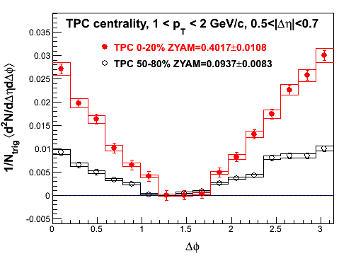
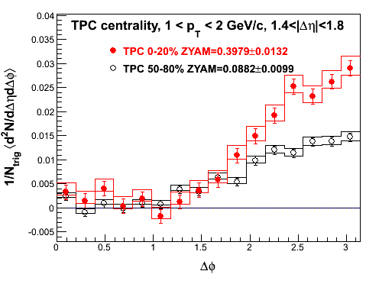
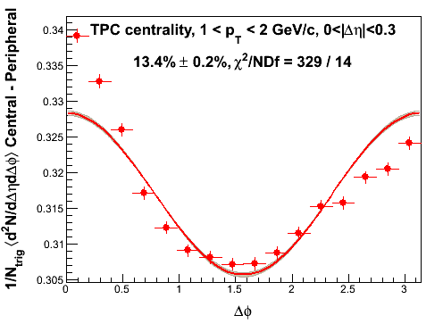
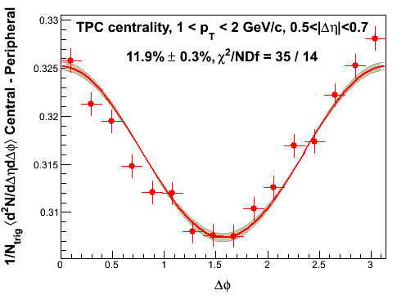
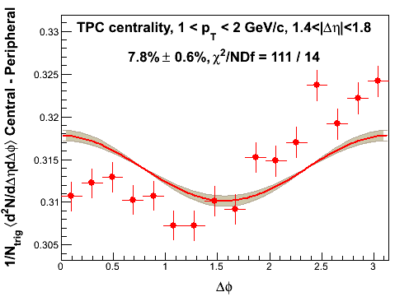
Δφ projections in different Δη
(TPC multiplicity |η|<1 as centrality)
0.15 <p_{T}^{trig} < 3.0 GeV/c, 1<p_{T}^{assoc}< 2 GeV/c
STAR preliminary
STAR preliminary
STAR preliminary
ZYAM
ZYAM
ZYAM
STAR preliminary
STAR preliminary
STAR preliminary
direct difference
no ZYAM
direct difference
no ZYAM
direct difference
no ZYAM
ZYAM syst. error from different sizes of Δφ region for ZYAM.
• efficiency corrected: 85 ± 5%

Slide 14
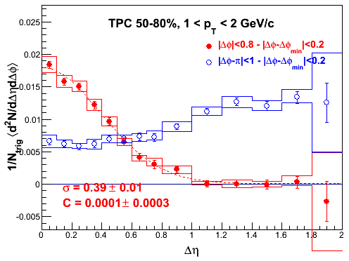
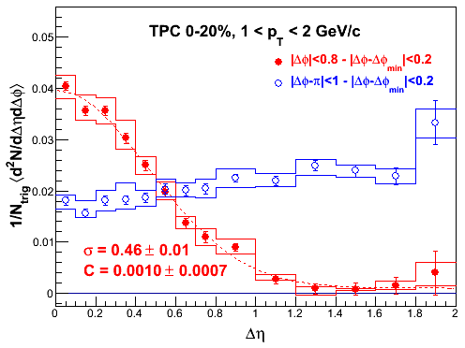
Δη projections in different Δφ
(TPC multiplicity |η|<1 as centrality)
STAR preliminary
STAR preliminary
Δφ
Δη
Δφ
0.15 <p_{T}^{trig} < 3.0 GeV/c, 1<p_{T}^{assoc}< 2 GeV/c
Δη
STAR preliminary
STAR preliminary
ZYAM syst. error from different sizes of Δφ region for ZYAM.
• efficiency corrected: 85 ± 5%

Slide 15
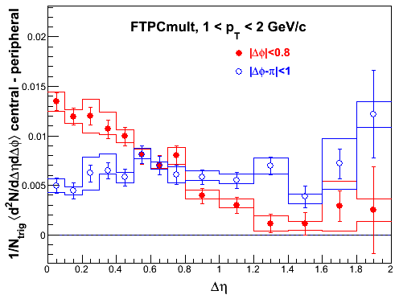
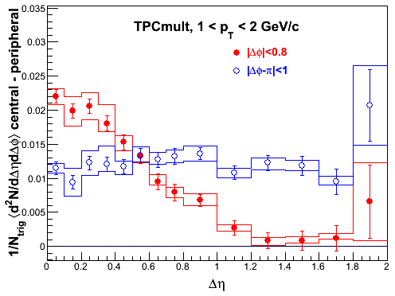
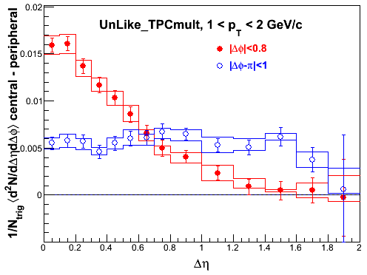
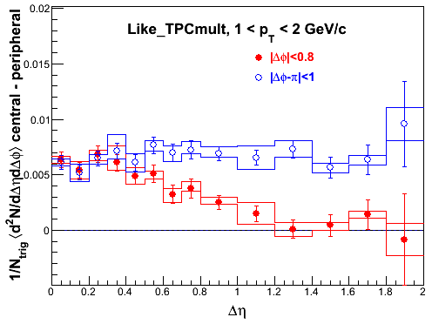
Central-peripheral correlation functions,
charge dependence
0.15 <p_{T}^{trig} < 3.0 GeV/c, 1<p_{T}^{assoc}< 2 GeV/c
FTPC 0-20% - 40-100%
TPC 0-20% - 50-80%
STAR preliminary
STAR preliminary
unlike-sign
like-sign
TPC 0-20% - 50-80%
TPC 0-20% - 50-80%
STAR preliminary
STAR preliminary
“Near-side peak” shows jet-like features of charge-ordering.

Slide 16
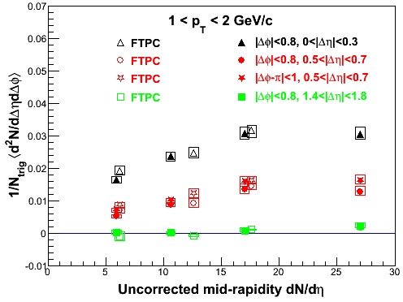
Conditional yield vs multiplicity
0.15 <p_{T}^{trig} < 3.0 GeV/c, 1<p_{T}^{assoc}< 2 GeV/c
STAR preliminary
TPC
Conditional yield in d+Au is consistent with zero for
1.4 <|Δη|<1.8 as a function of centrality.
ongoing studies of p_{T} dependence

Slide 17
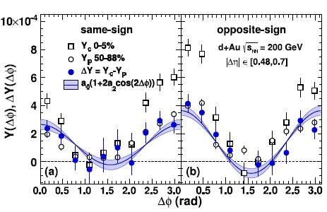
Comparison with PHENIX
PHENIX, arXiv:1303.1794
p_{T}=1.25-1.5 GeV/c
Use the same acceptance cuts as PHENIX:
PHENIX measurement is likely
contaminated by jet contribution
PHENIX Δη acceptance window
STAR preliminary
direct difference
no ZYAM
STAR preliminary
minimal ridge

Slide 18
Looking forward …
CGC ?
Forward jet
Forward jet
p
p
d
Au
Mid-rapidity jet
Mid-rapidity jet

Slide 19
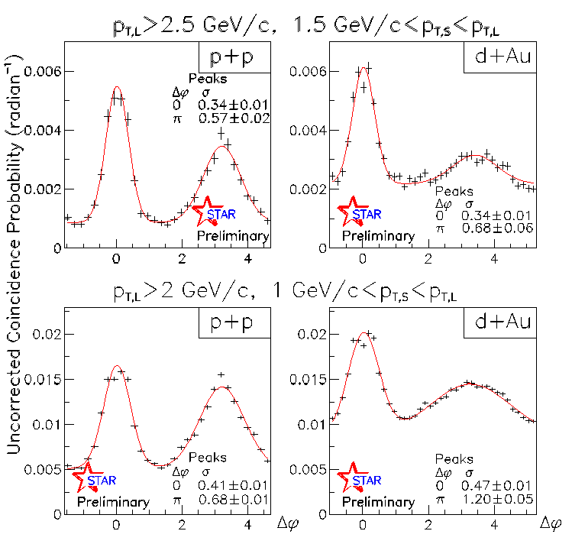
Forward π−π azimuthal correlations
<η_{π,L}>=3, <η_{π,S}>=3
forward π⁰ pairs probe the lowest x
2→2 scattering:
0.001 < x < 0.005
forward π⁰ pairs detected via 4 γ
jet-like correlations for p+p consistent with NLO pQCD description of inclusive forward π⁰ cross section
significant broadening of away-side correlation peak observed
in d+Au relative to p+p
STAR, arXiv:1005.2378

Slide 20
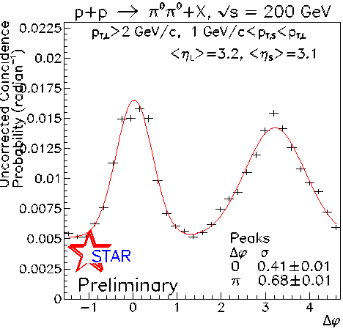
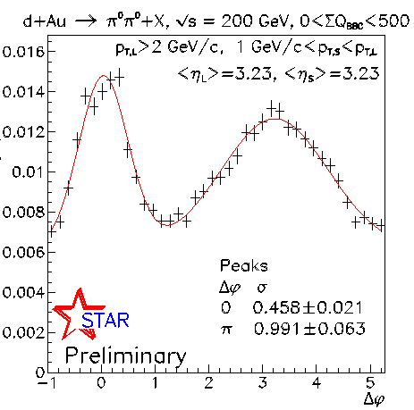
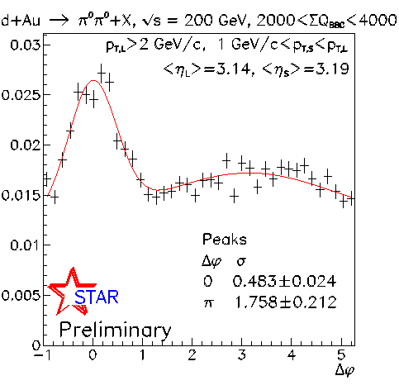
Centrality dependence of forward
π−π correlations
Leading p_{T} π⁰ > 2 GeV/c
dAu all data
p+p data
STAR, arXiv:1005.2378
d+Au peripheral
d+Au central
note: uncorrected coincidence probabilities
away-side peaks evident in p+p and peripheral d+Au
peripheral d+Au: away-side ~ 50% wider than in p+p
Away-side peak in d+Au shows significant
centrality dependence → clear azimuthal decorrelation.

Slide 21
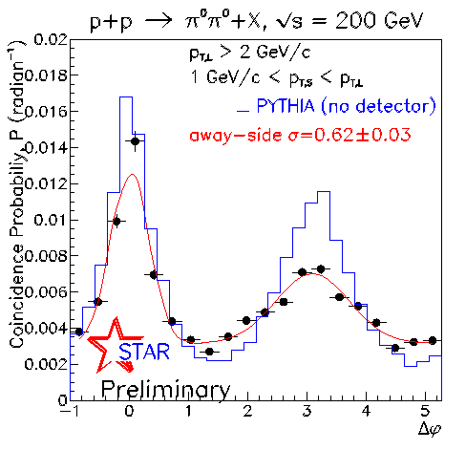
Corrected p+p coincidence probability
<η_{π,L}>=3, <η_{π,S}>=3
Apply off-mass-peak subtraction and efficiency correction
to p+p data
Conclusions:
away-side peak width comparable to uncorrected azimuthal correlations
N.B. σ (uncorr.) = 0.68±0.01
near-side peak agrees with PYTHIA
away-side peak broader than PYTHIA
pedestal appears larger than PYTHIA
PYTHIA 6.222

Slide 22
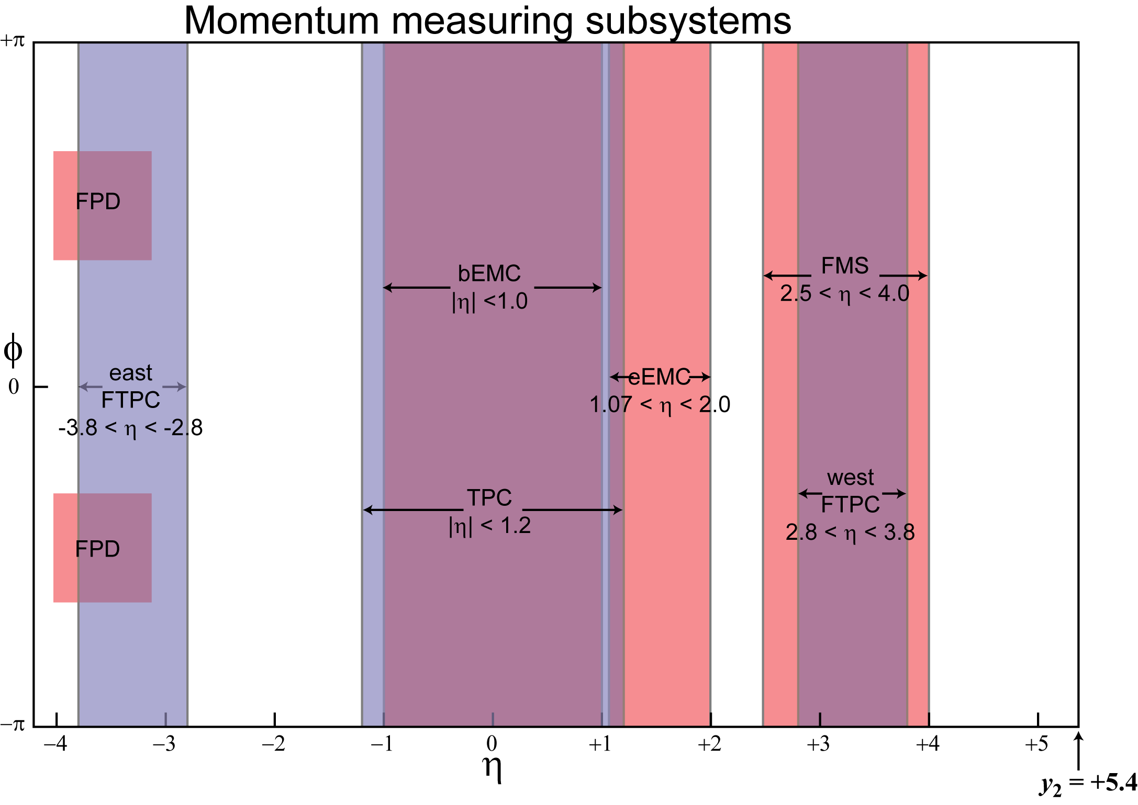
Pseudorapidity dependence of forward π⁰+jet-like correlations
STAR
study correlations of π⁰
from FMS (η~3)
with “jet-like” clusters
from EEMC (η~1.5)
or BEMC (η~0)
“jet-like” clusters
are reconstructed within
a cone of R=0.6 with a seed from high-tower
π⁰
π⁰
jet-like
cluster
jet-like
cluster
jet-like
cluster
EEMC/BEMC selection
criteria:
- 600 (400) MeV tower
threshold
- 0.4 (0.2) GeV/c² lower
mass limit for jet-like cluster
π⁰
d
Au

Slide 23
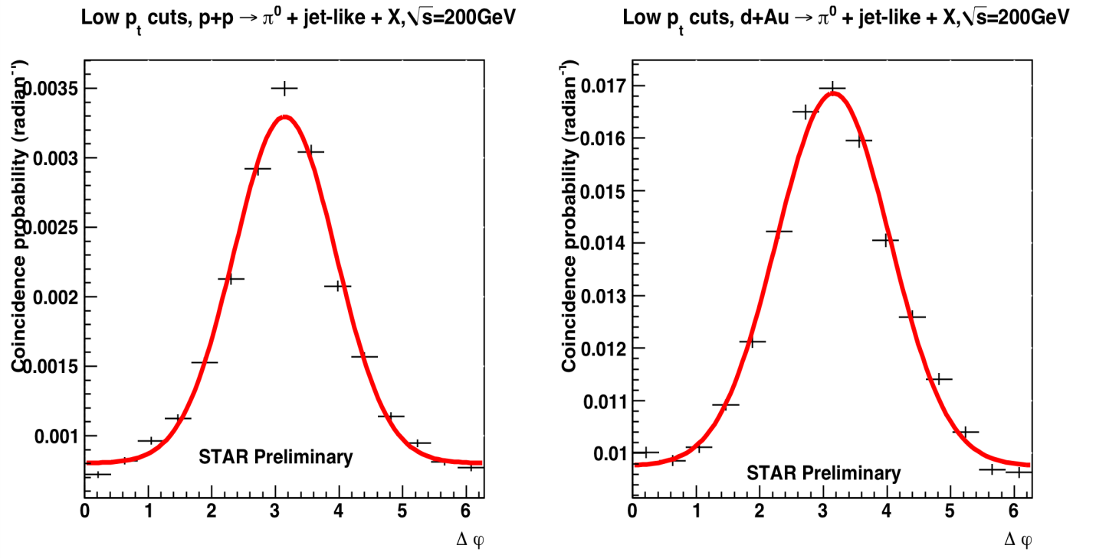
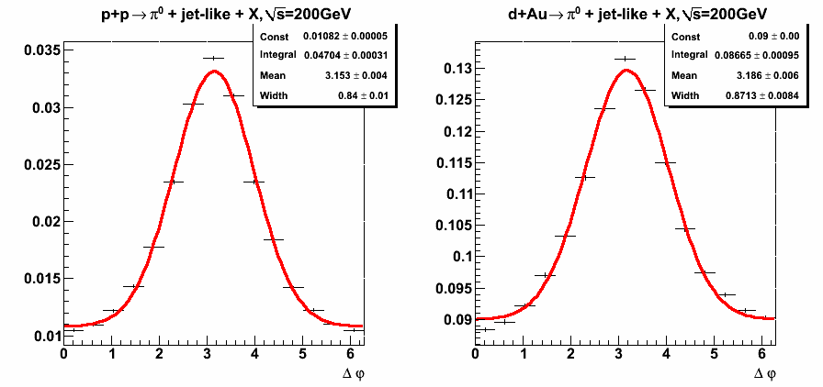
FMS (π⁰) - jet-like cluster correlations
y
p_{T}(FMS) > 2.0 GeV/c ; 1.0 GeV/c < p_{T}(jet-like cluster) < p_{T}(FMS)
FMS π⁰
p+p
<η_{πL}>=3,
<η_{jet-ike}>=1.5
d+Au
z
BEMC EEMC jet-like cluster
mixed event correction applied
caveat: jet energy scale not fixed
between different detectors, but
this does not change conclusions
p+p correlations become narrower
as η increases
d+Au correlations become broader
as η increases
EEMC
EEMC
<η_{πL}>=3,
<η_{jet-like}>=0
FMS-EEMC:
BEMC
BEMC
STAR Preliminary
STAR Preliminary
FMS-BEMC:
Significant broadening from p+p to d+Au
for FMS-EEMC correlations observed.
23

Slide 24
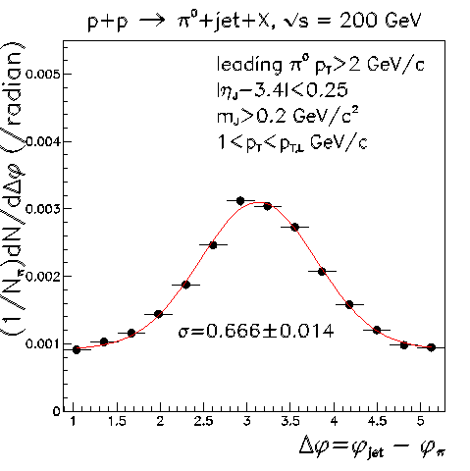
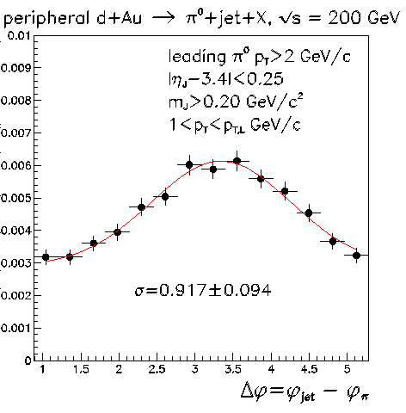
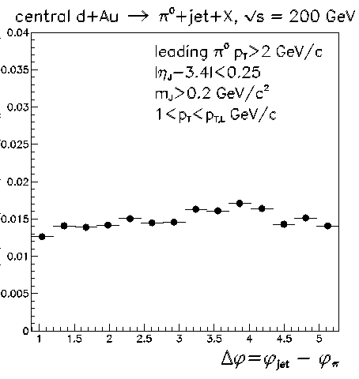
Centrality dependence of π⁰+jet-like correlations
STAR Preliminary
STAR Preliminary
STAR Preliminary
mixed-event corrections applied, results in ~15% bin-to-bin changes
use beam-beam counter facing Au beam to select peripheral (ΣQ<250)
and central (2000<ΣQ<4000) collisions
No evidence of away-side peak for central d+Au collisions. Pronounced cold nuclear matter effects in the forward direction.

Slide 25
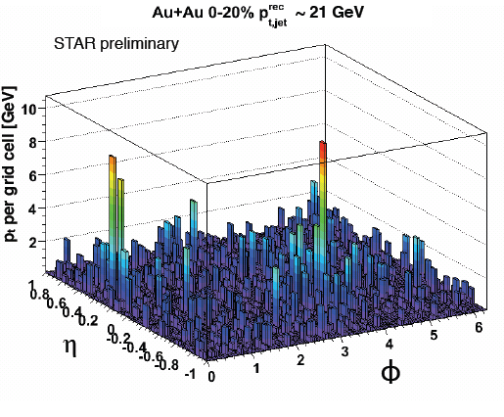
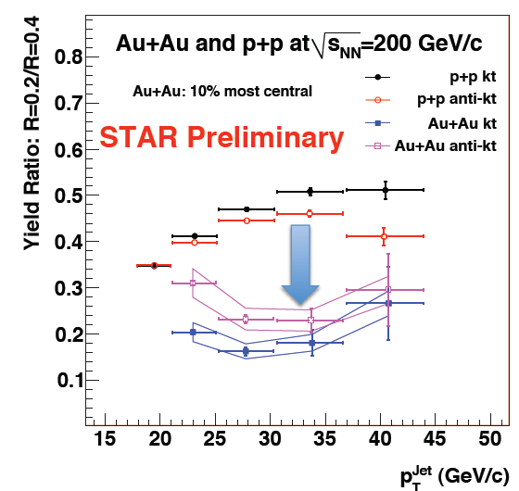
Full jet reconstruction in Au+Au collisions …
Early Quark Matter ’09 results on Run 7 Au+Au data at 200 GeV
- limited statistics, new methods developed since then

Slide 26
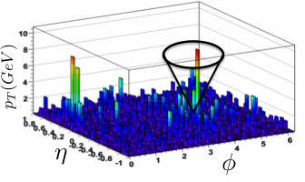
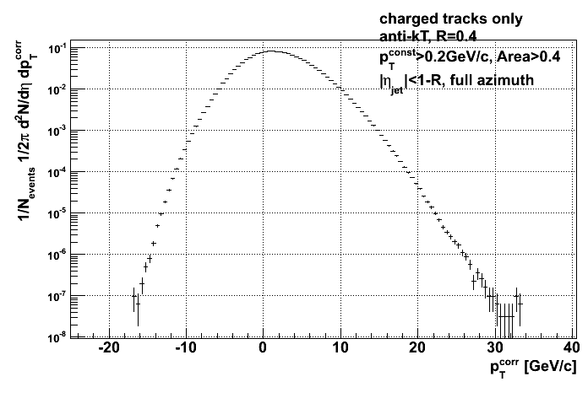
Large and fluctuating background in Au+Au collisions
STAR Preliminary
event-wise estimate of background density ρ
(k_{t}, FastJet):
A … jet area
Caution: definition of ρ is not unique:
  e.g. exclude two hardest jets in event
  vary choice →contribution to syst. uncertainty
jet candidate p_{T} is corrected event-wise for ρ:
ρ = median{p_{T,i} /A_{i} ^{jet} }
p_{T,i}^{corr} ~ p_{T,i}^{reco} - ρ x A_{i}
Large fraction of jet population has p_{T}^{<corr>} < 0:
not interpretable as physical jets
BUT this component contains crucial information about background or “combinatorial” jets
Note: it is rejected implicitly at later step by
imposition of bias on jet candidates
STAR Preliminary

Slide 27
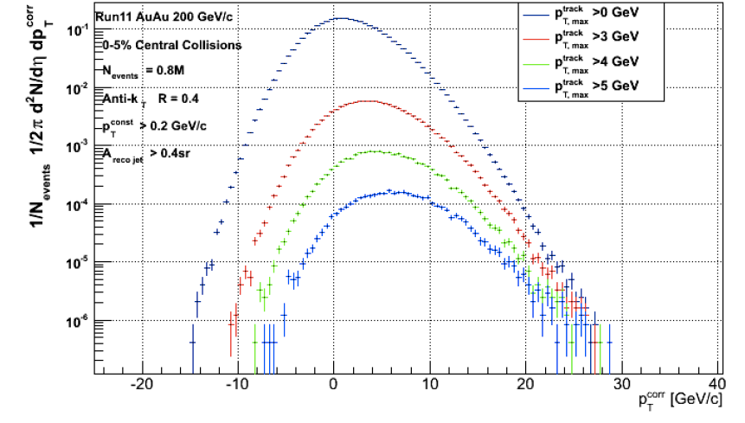
Inclusive jet spectrum in central Au+Au
Run11 Au+Au data at 200 GeV
jets reconstructed using IR safe anti-k_{t} algorithm with R=0.4
currently only charged jets (for simplicity)
minimum constituent cut (p_{T}^{const}>200 MeV/c for tracks)
exploratory study on small fraction of data (1%)
STAR preliminary
unbiased
biased
Stable unfolding requires each jet candidate to have
at least one constituent with p_{T} greater than a threshold value.
G. de Barros et al., arXiv:1208.1518

Slide 28
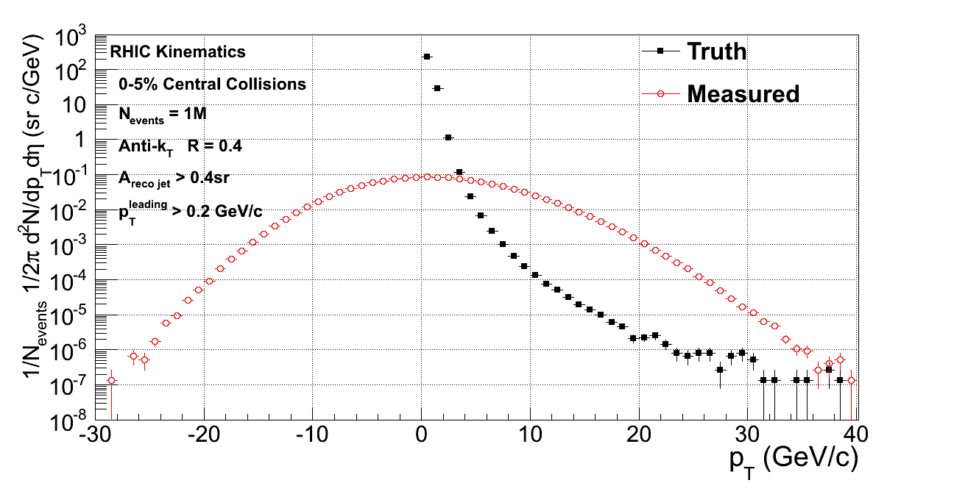


Unfolding of background fluctuations
Standard methods:
Bayesian
Singular Value Decomposition (SVD)
Methods tested in parallel using
a “Toy model” Monte-Carlo
Response matrix measured by embedding simulated “jets” into real events → δp_{T}
Toy model
Work in progress
J. Rusnak (STAR)
Stable convergence for p_{T}^{leading}>5 GeV/c, ~20% sensitivity to choice of prior.

Slide 29

Estimate of jet yields in Run11 Au+Au data
STAR, Phys. Rev. Lett. 97 (2006) 252001
Run 11 Au+Au integrated luminosity:
~ 2.8/nb
Estimate jet production yield
(i.e. R_{AA}=1):
R=0.4
10% central Au+Au in Run11:
We expect ~2K jets with p_{T}>50 GeV/c.
STAY tuned ☺

Slide 30
Summary and outlook
v₃ may be due to Δη dependent fluctuations (e.g. a la Glasma).
STAR data show no ridge, within measurement uncertainties,
in d+Au collisions.
Observed pronounced cold nuclear matter effects in di-hadron
correlations in forward direction.
Work in progress on full jet reconstruction in Au+Au collisions.
methods tested, unfolding under control
More interesting results from STAR to come ☺

